Slide 1

Solar Data
Browse and Obtain

Slide 2
Outline
Data/instrument overview
Online resources for browsing and acquiring data
Basic Data Prep

Slide 3
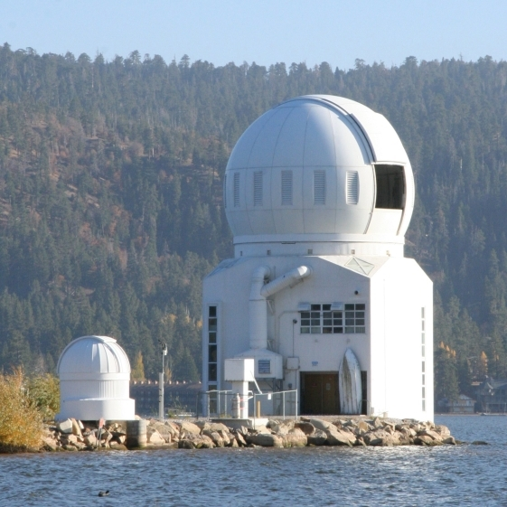
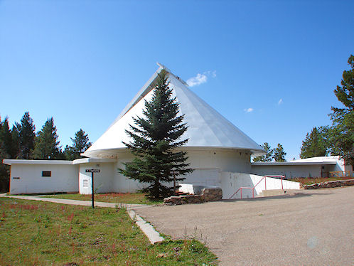
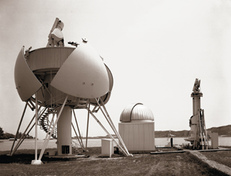
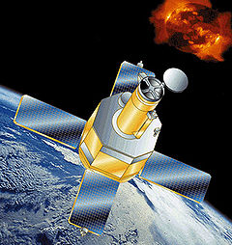
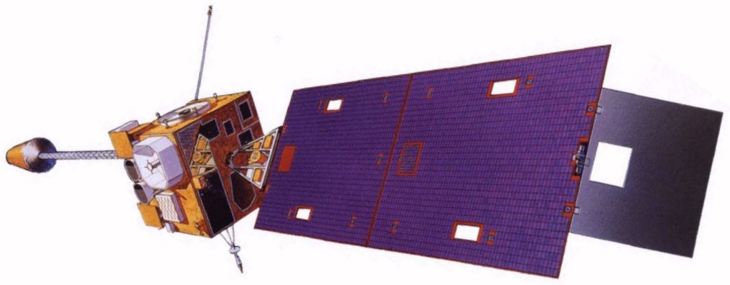
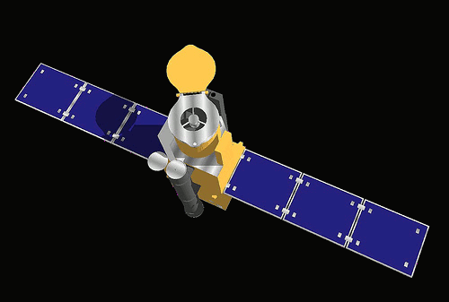
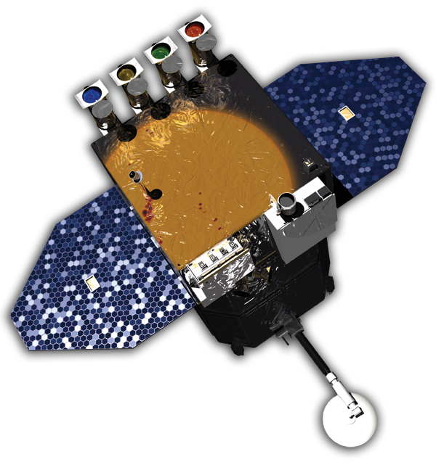
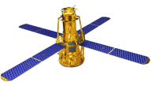
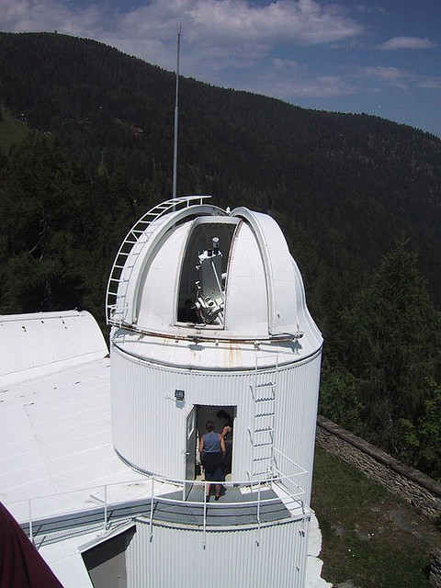
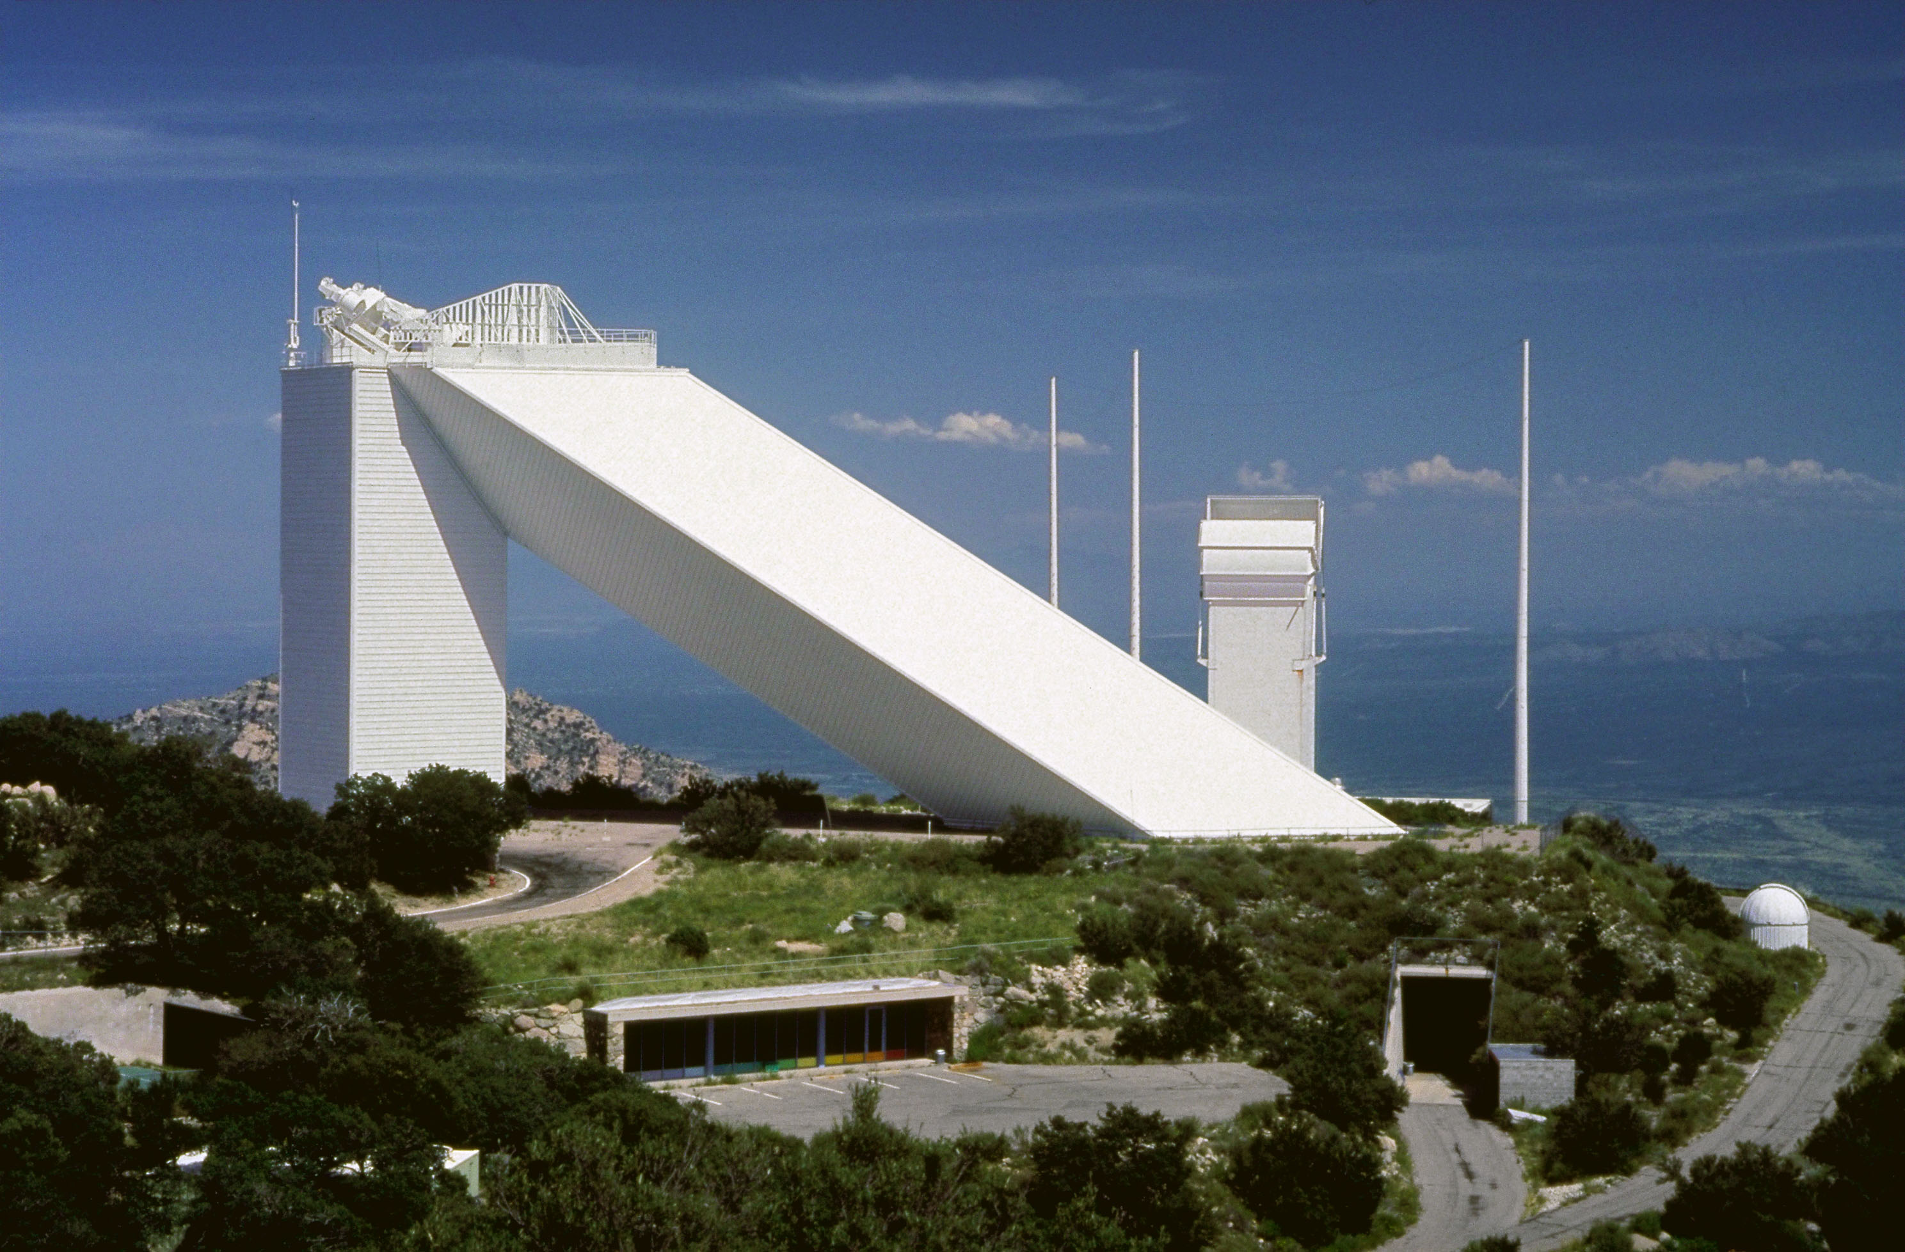
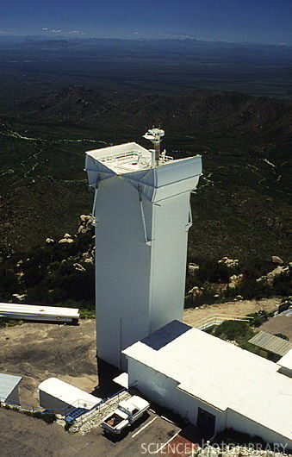
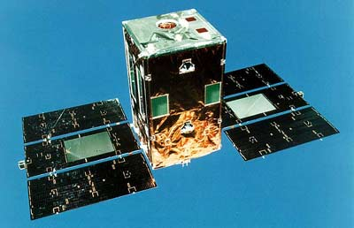
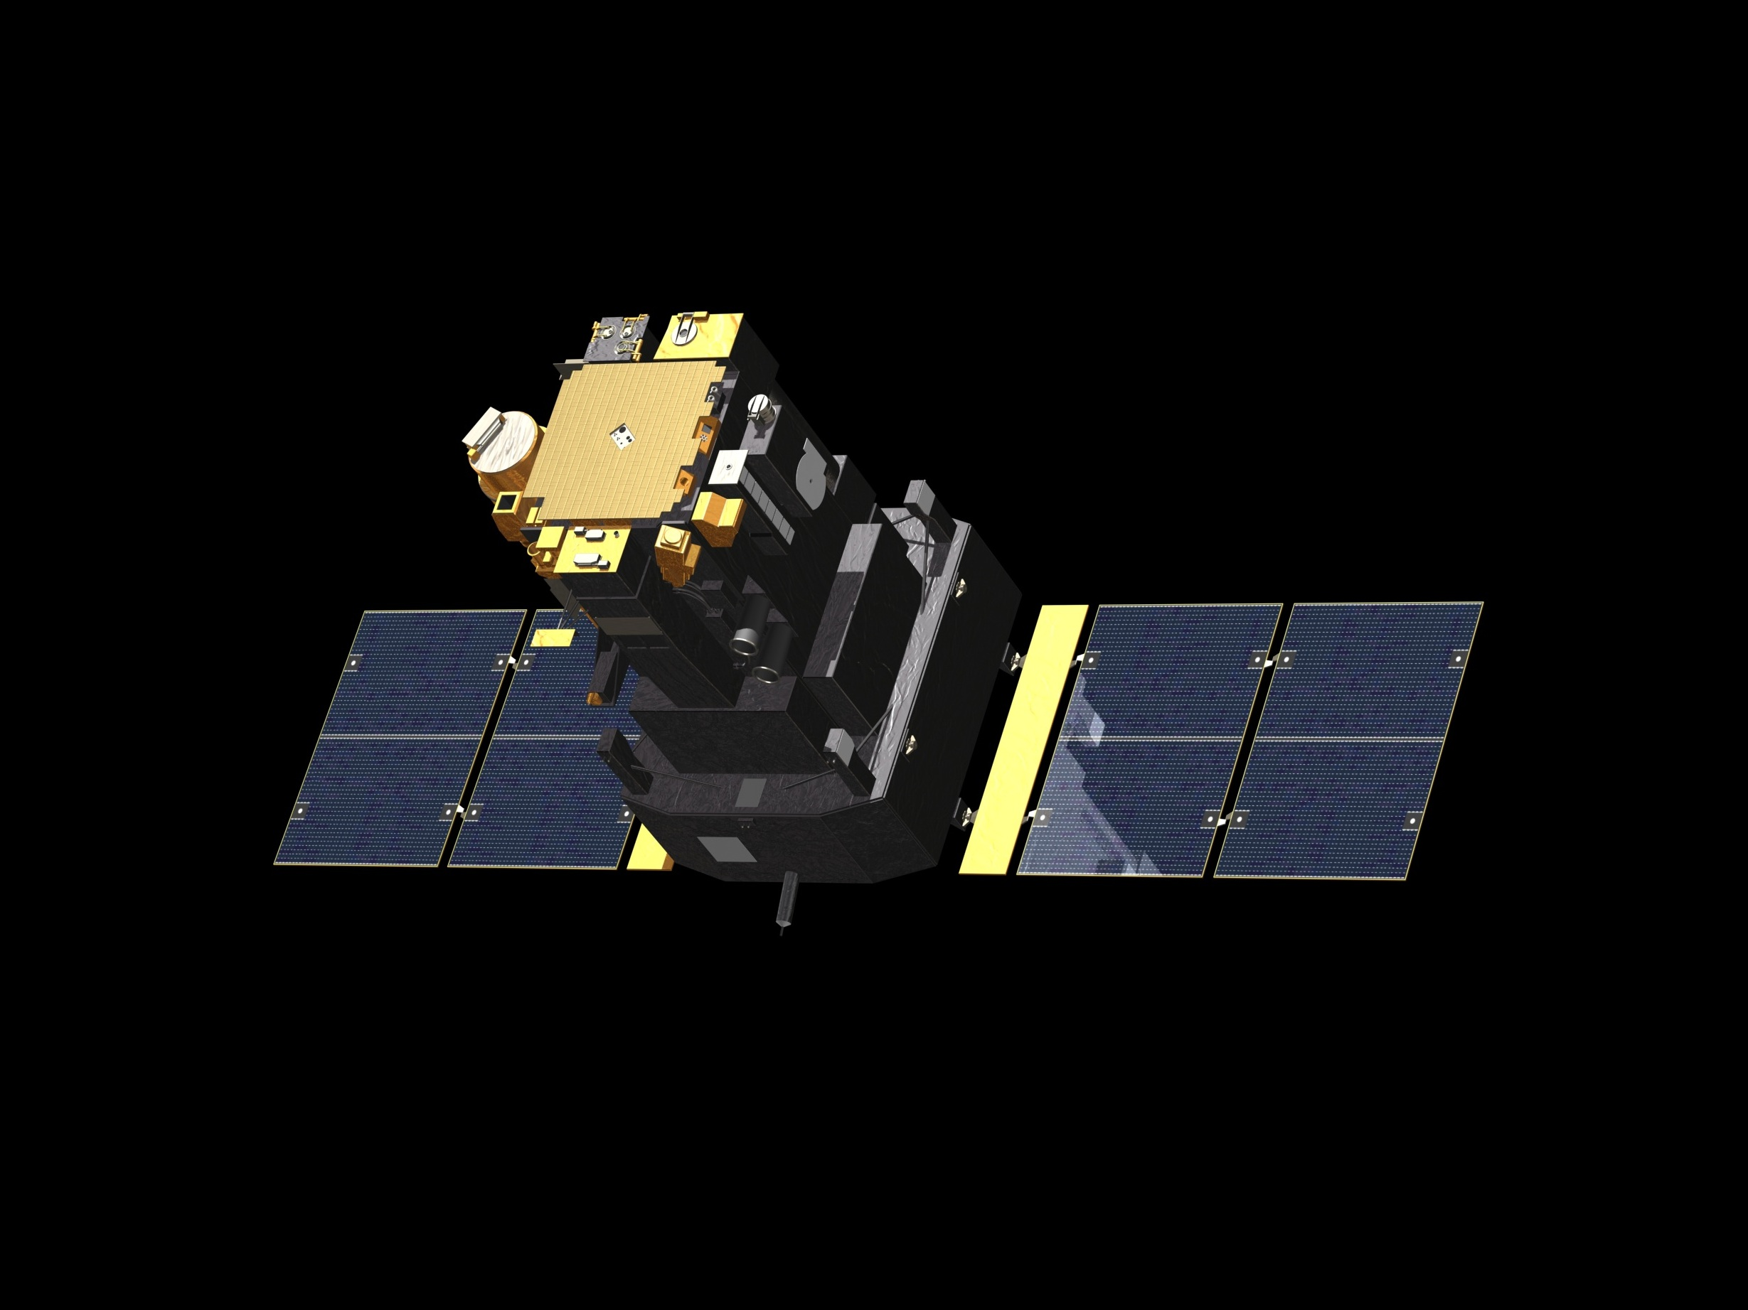
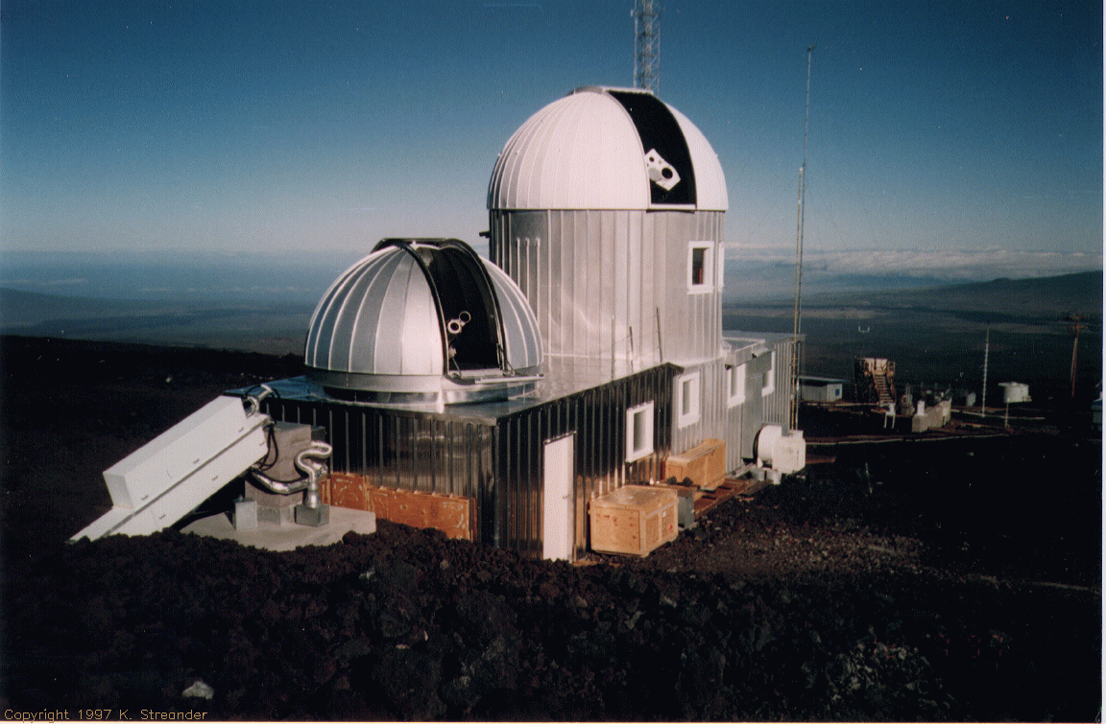
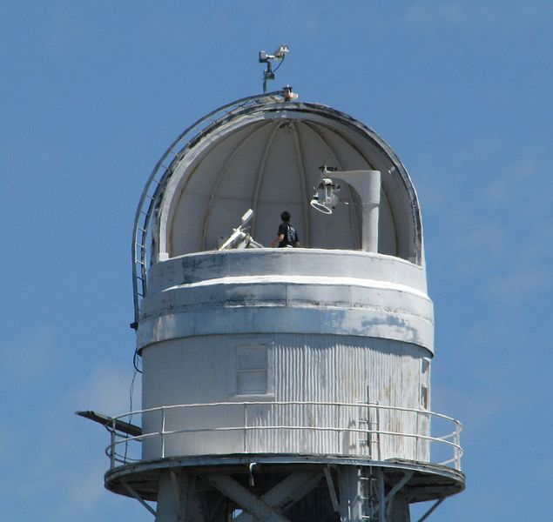
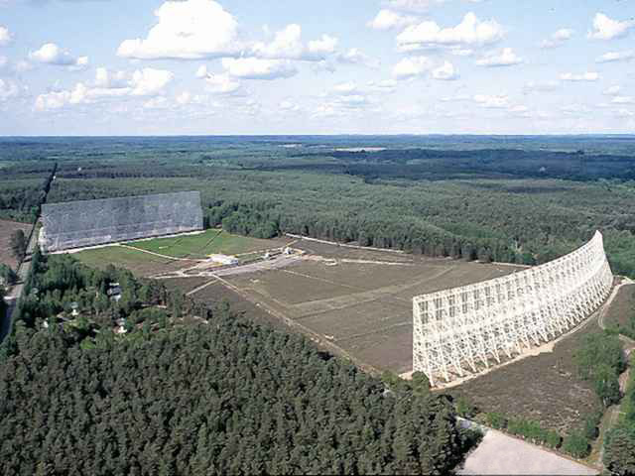
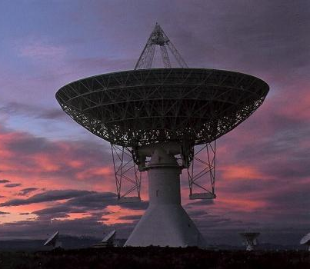
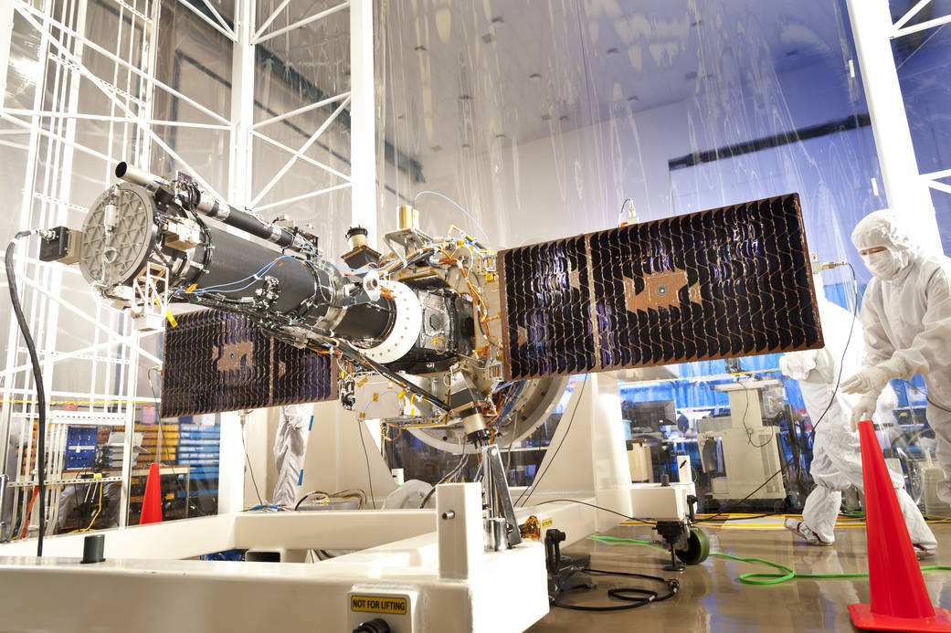
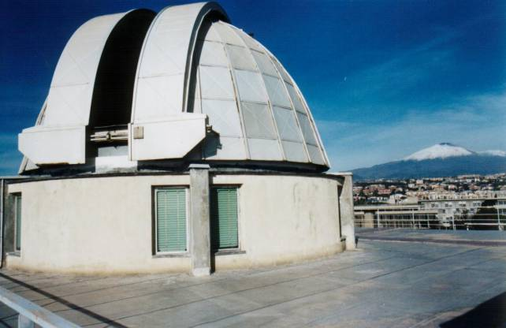
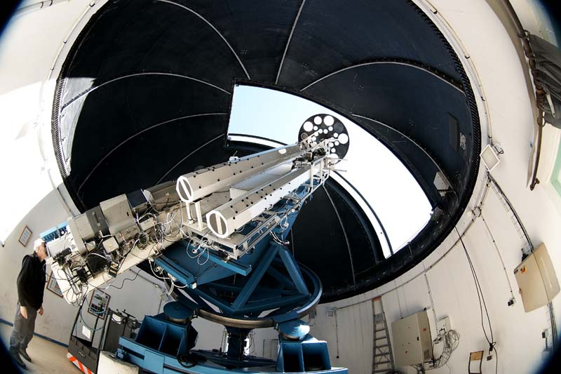
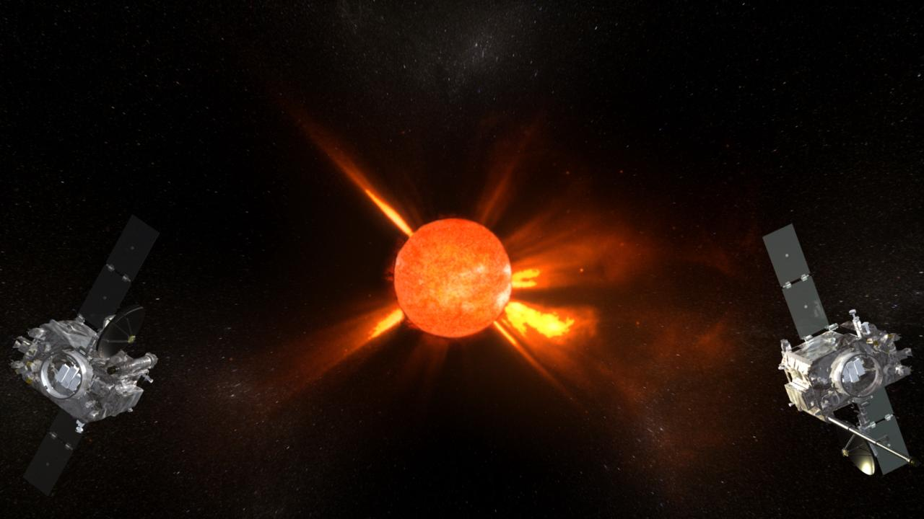
Big Bear Solar Obs.
Evans Solar Telescope
San Fernando Observatory
TRACE
GOES – 13,15
Hinode (Solar B)
SDO
RHESSI
Kanzelhöhe Solar Obs.
McMath Solar Telescope
Vacuum Tower Telescope
YOHKOH (Solar A)
SOHO
Mauna Loa Solar Observatory
Mt Wilson Solar Observatory
Nançay Radio Observatory
Osservatorio Astrofisico di Catania
Observatoire du Pic du Midi
Owens Valley Radio Observatory
STEREO A & B
IRIS

Slide 4
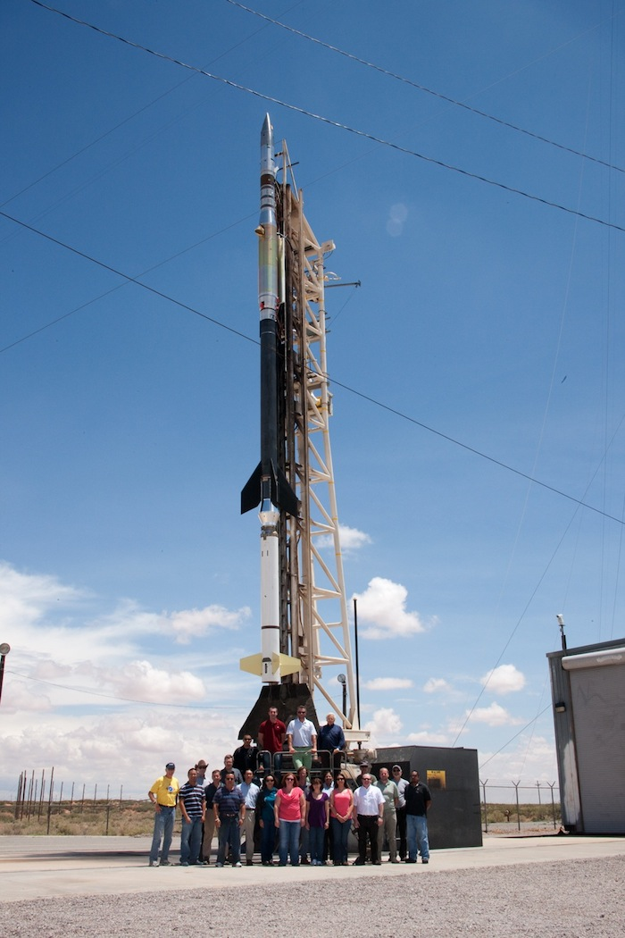
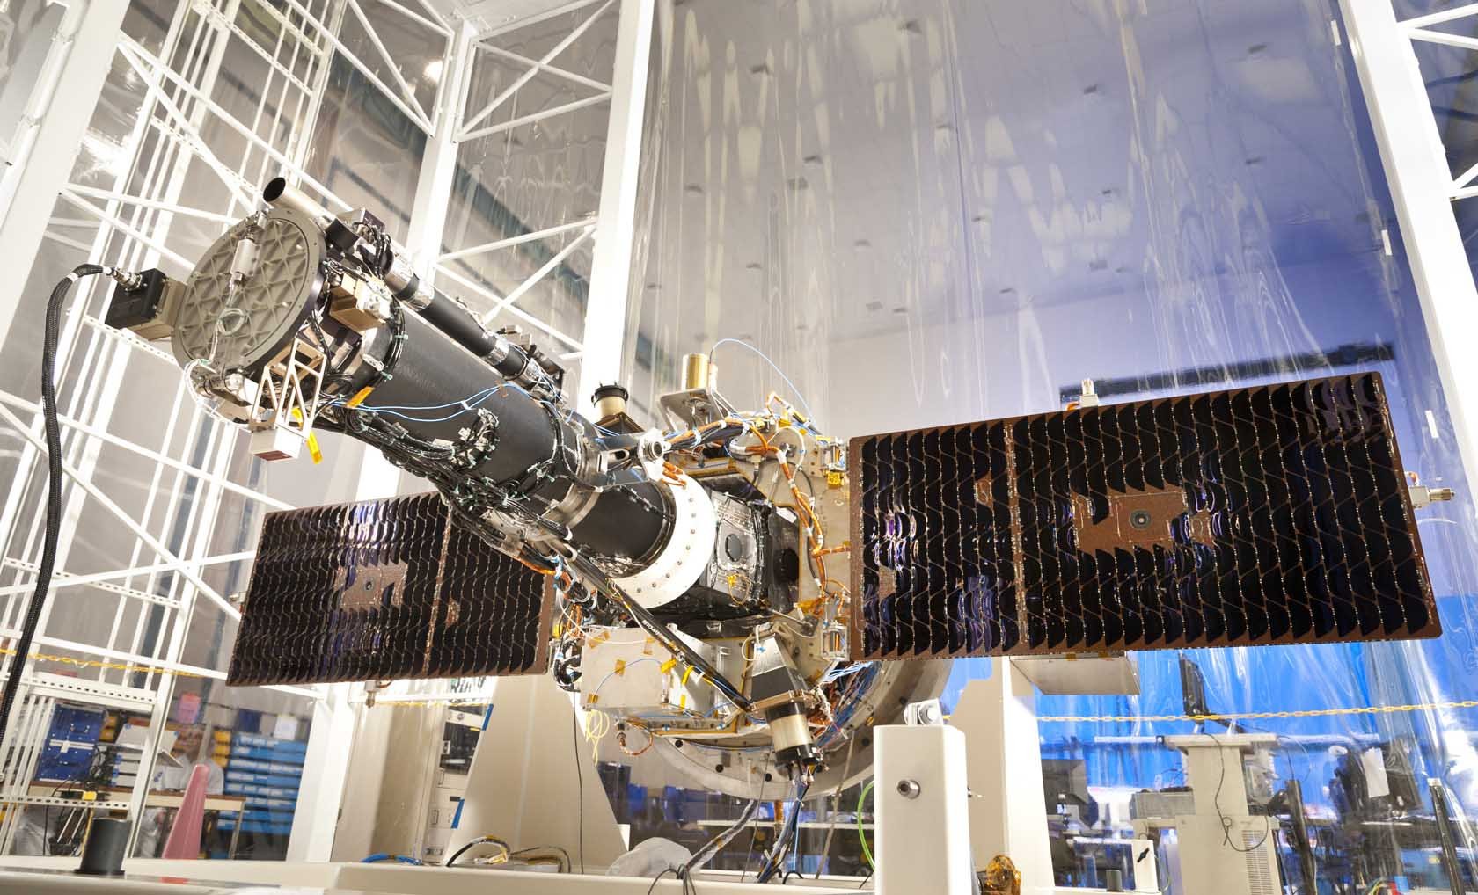
Big Bear Solar Obs.
Evans Solar Telescope
San Fernando Observatory
TRACE
GOES – 12
Hinode (Solar B)
SDO
RHESSI
Kanzelhöhe Solar Obs.
McMath Solar Telescope
Vacuum Tower Telescope
YOHKOH (Solar A)
SOHO
Mauna Loa Solar Observatory
Mt Wilson Solar Observatory
Nançay Radio Observatory
Osservatorio Astrofisico di Catania
Observatoire du Pic du Midi
Owens Valley Radio Observatory
STEREO A & B

Slide 5
Big Bear Solar Obs.
Evans Solar Telescope
San Fernando Observatory
TRACE
GOES – 12
Hinode (Solar B)
SDO
RHESSI
Kanzelhöhe Solar Obs.
McMath Solar Telescope
Vacuum Tower Telescope
YOHKOH (Solar A)
SOHO
Mauna Loa Solar Observatory
Mt Wilson Solar Observatory
Nançay Radio Observatory
✗
Osservatorio Astrofisico di Catania
Observatoire du Pic du Midi
Owens Valley Radio Observatory
STEREO A & B

Slide 6
Solar Observables and Inferables
Observe
Intensity (Imaging: Hinode-XRT, IRIS, SDO/AIA)
Line Strengths (Spectroscopy: Hinode-EIS, IRIS, Ground based)
LOS Velocity (Doppler: Hinode-EIS, IRIS, SDO/HMI)
Polarization Vector (SDO/HMI)
Calculate
LoS Magnetic Field (Zeeman)
Vector Magnetic Field (LoS MF + Polarization)
Wave Power (acoustic-gravity waves)
Composition (Spectroscopy)
Morphology/Density (Intensity)

Slide 7
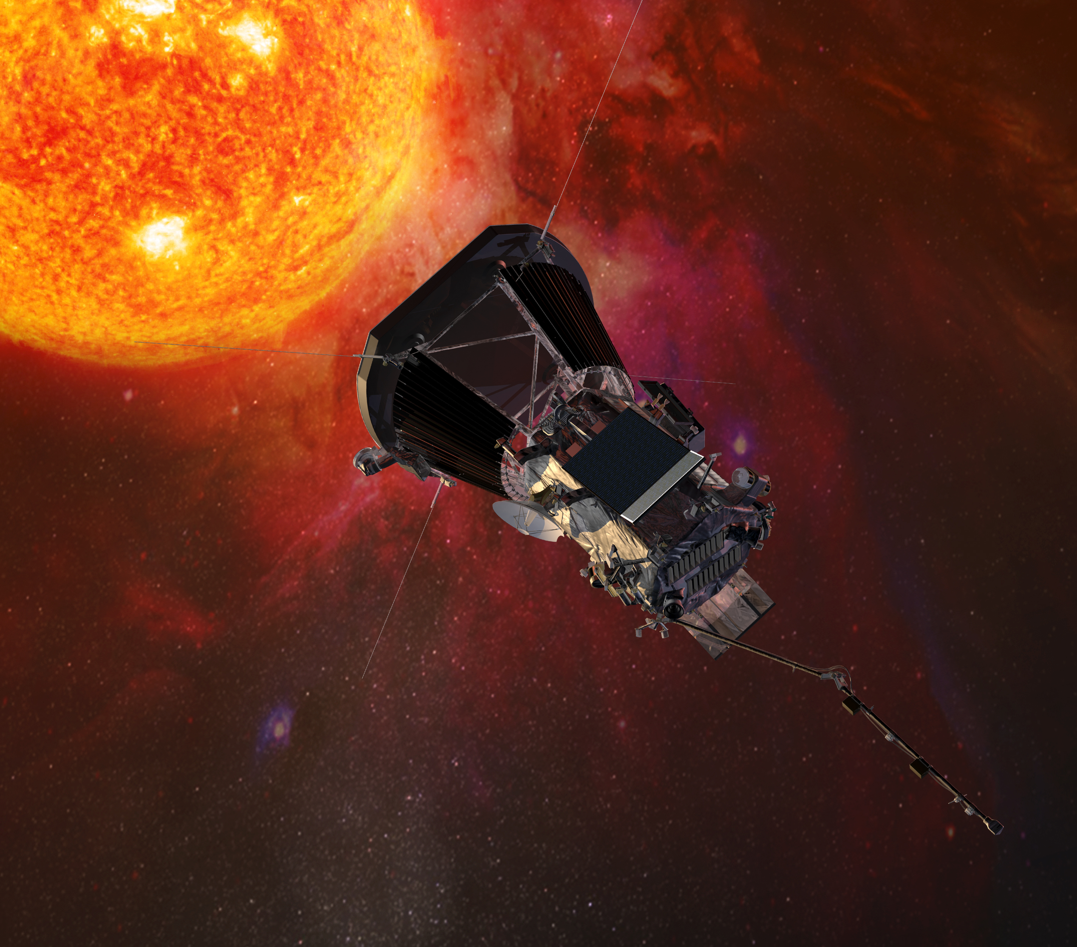
Solar Observables Coming Soon
Parker Solar Probe
9 Solar Radii
Number Density
Particle Flux
Particle Velocity
Thermal Velocity

Slide 8
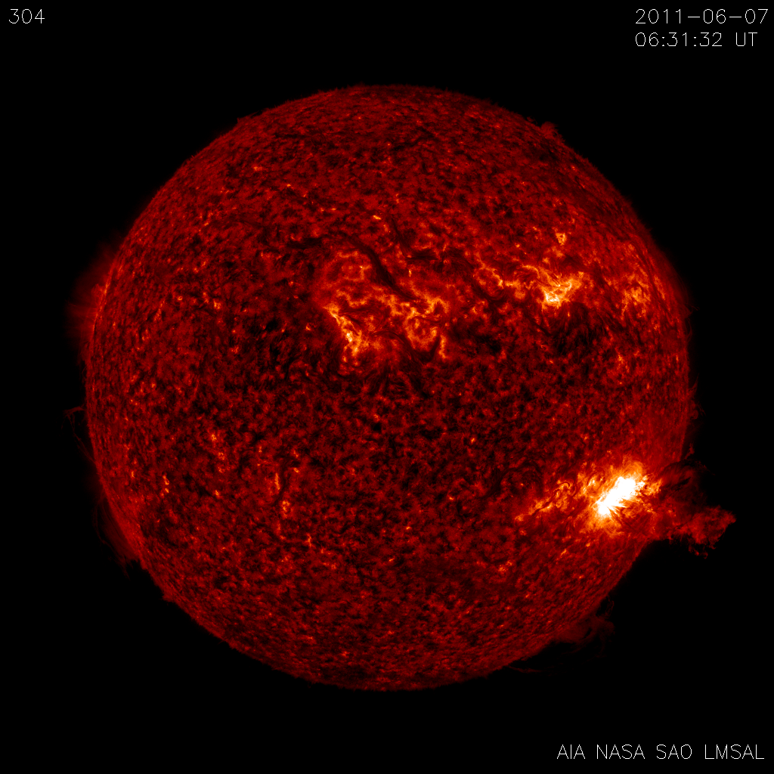
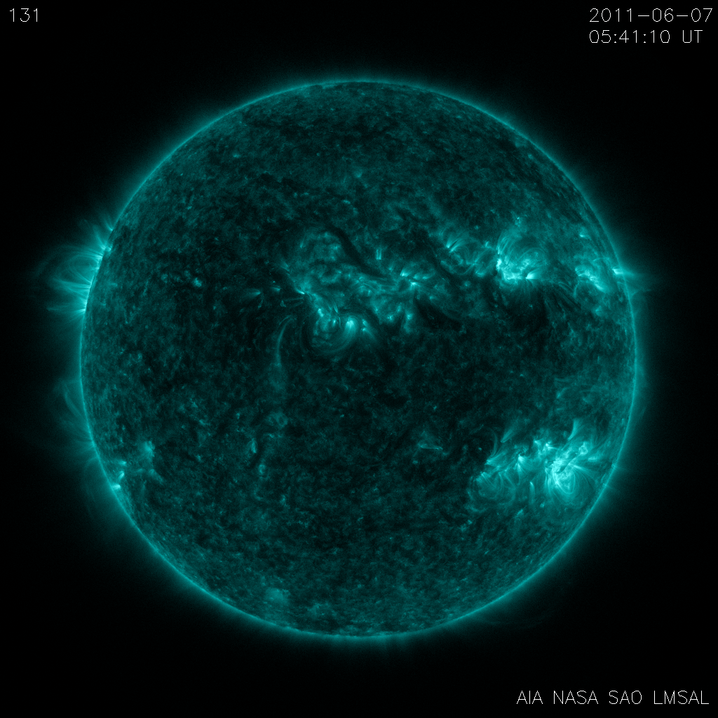
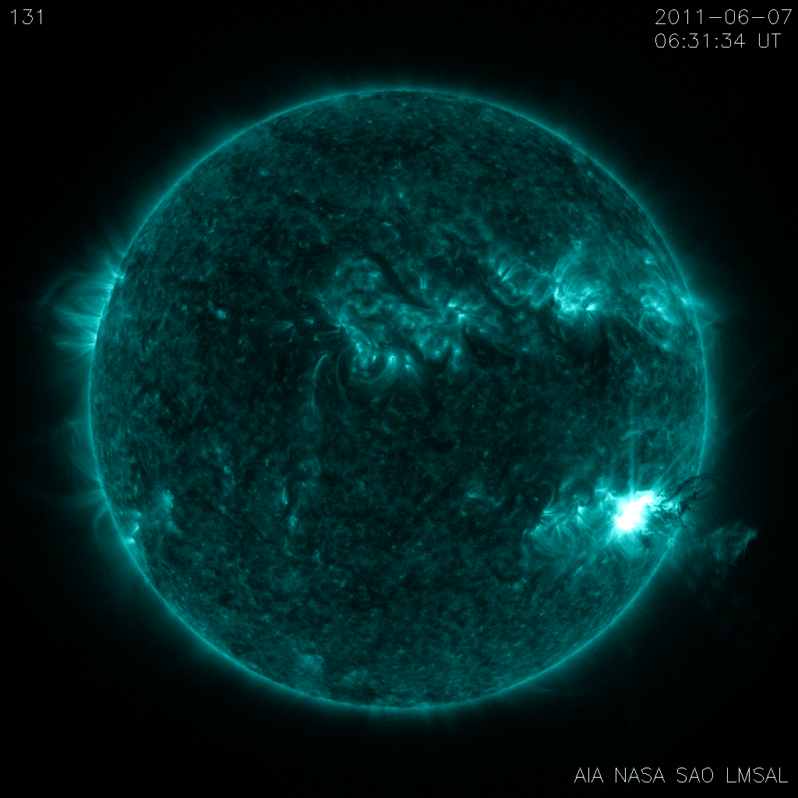
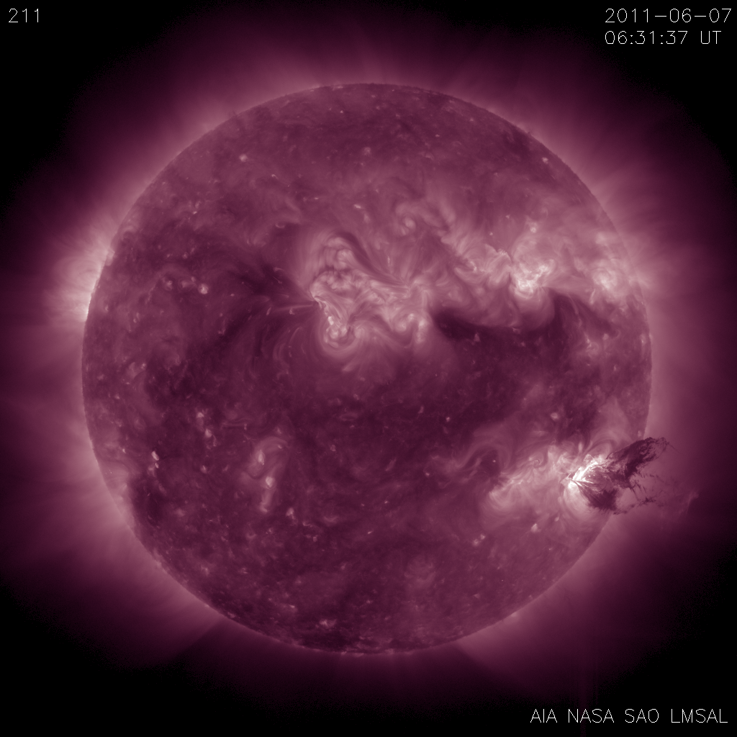
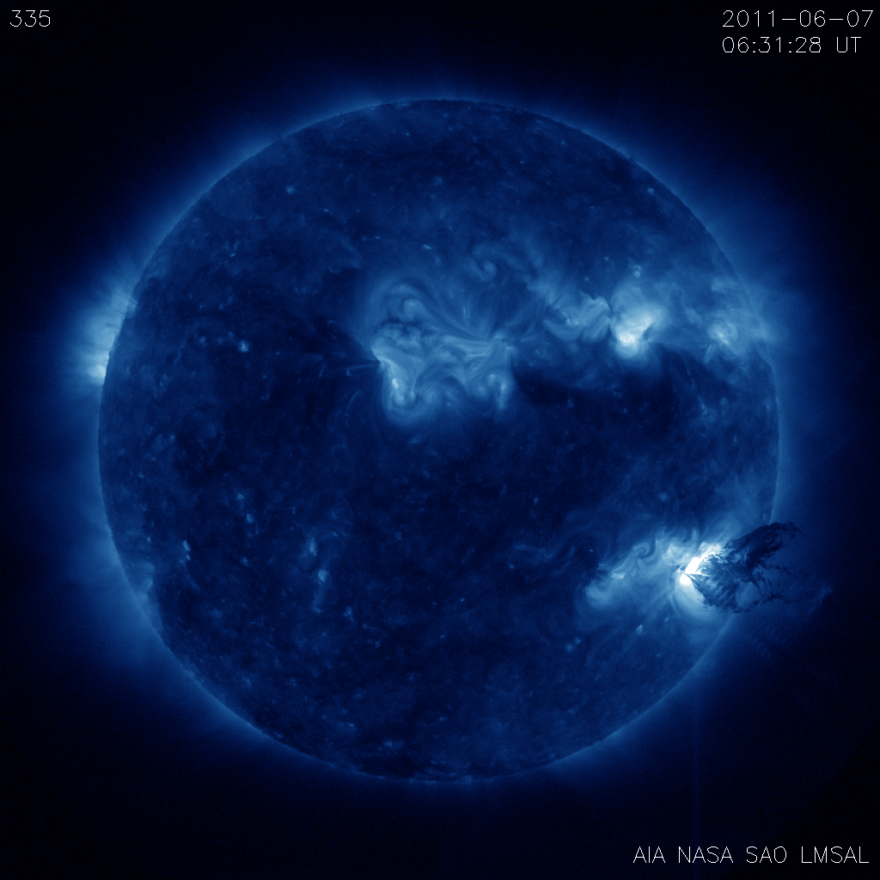
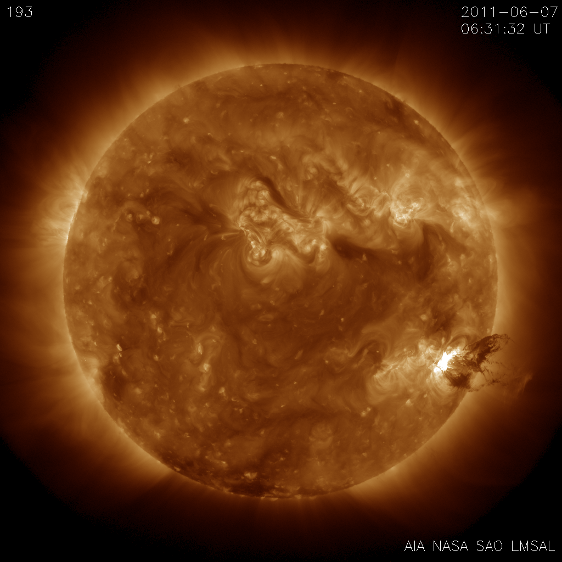
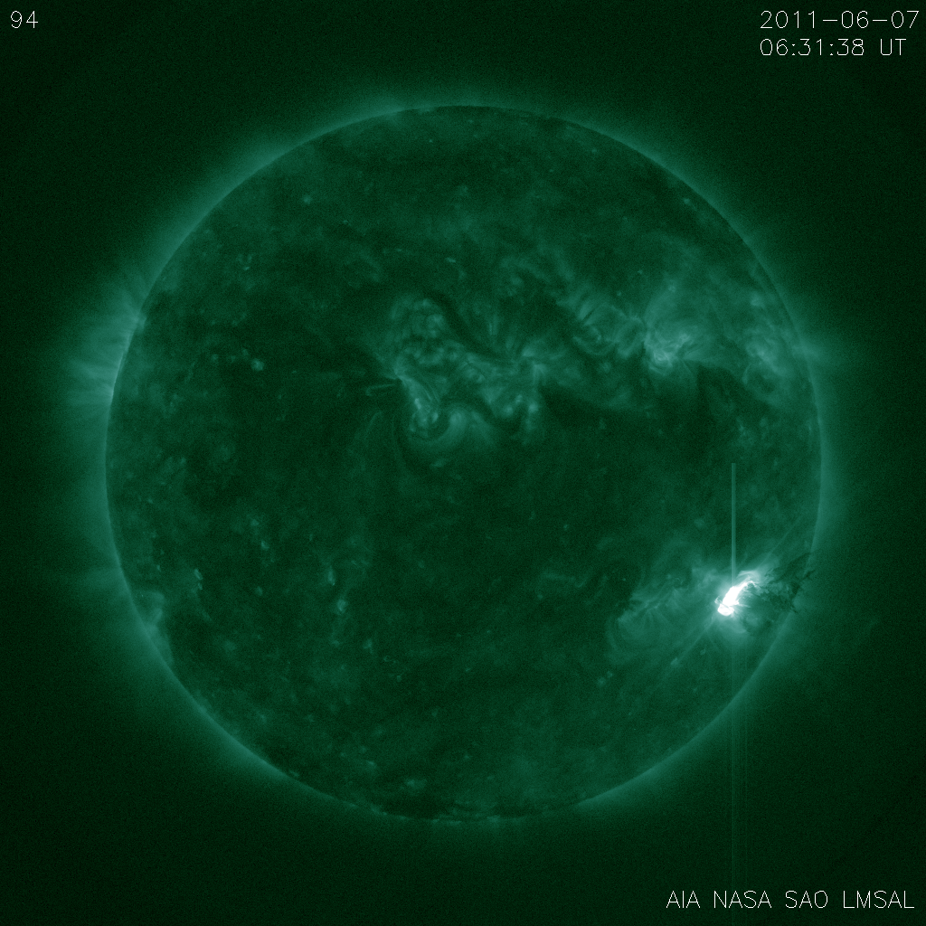
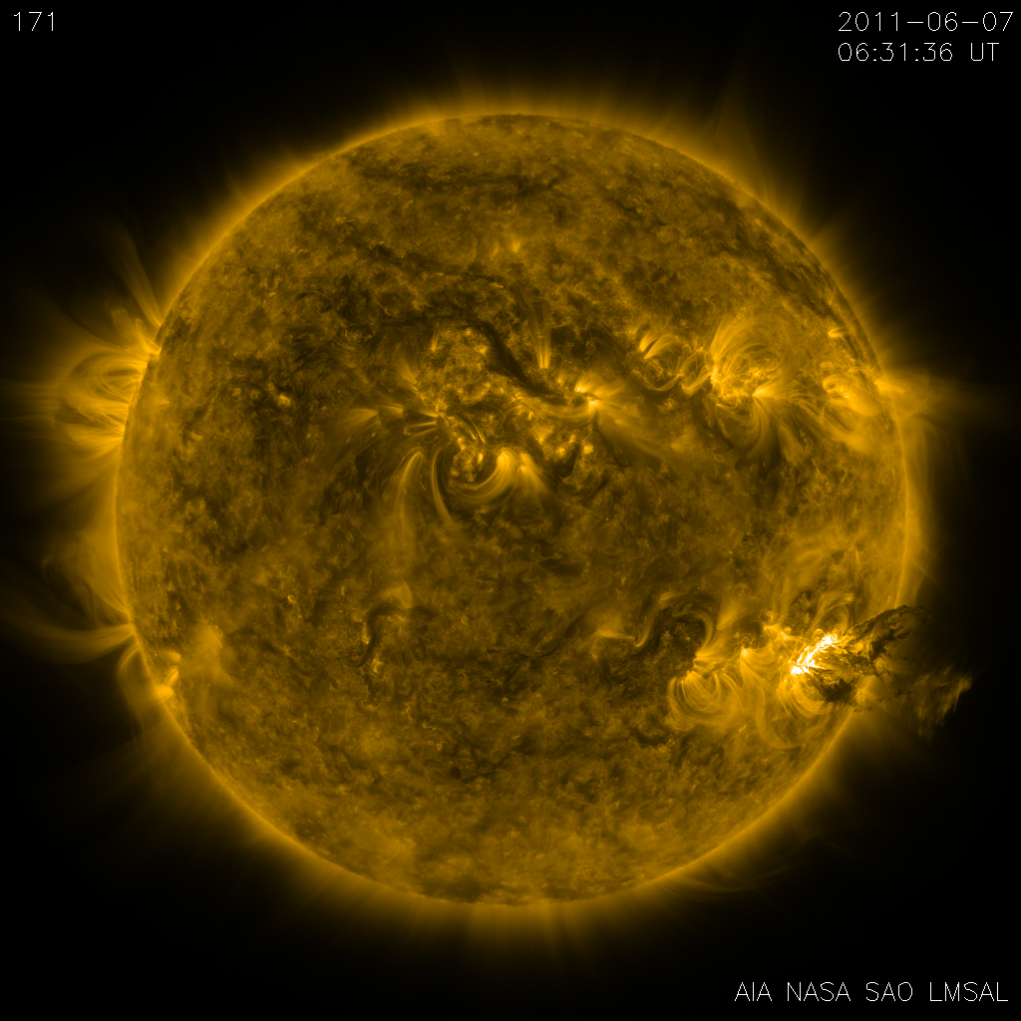
Atmospheric Imaging Assembly
Aboard SDO, launched 2010
EUV Imager
10 Channels, log(T)~3.7-7.2
4096px, 0.6’’/px
12s Cadence
Nearly 60K images per day
1+ TB/day (SDO)

Slide 9
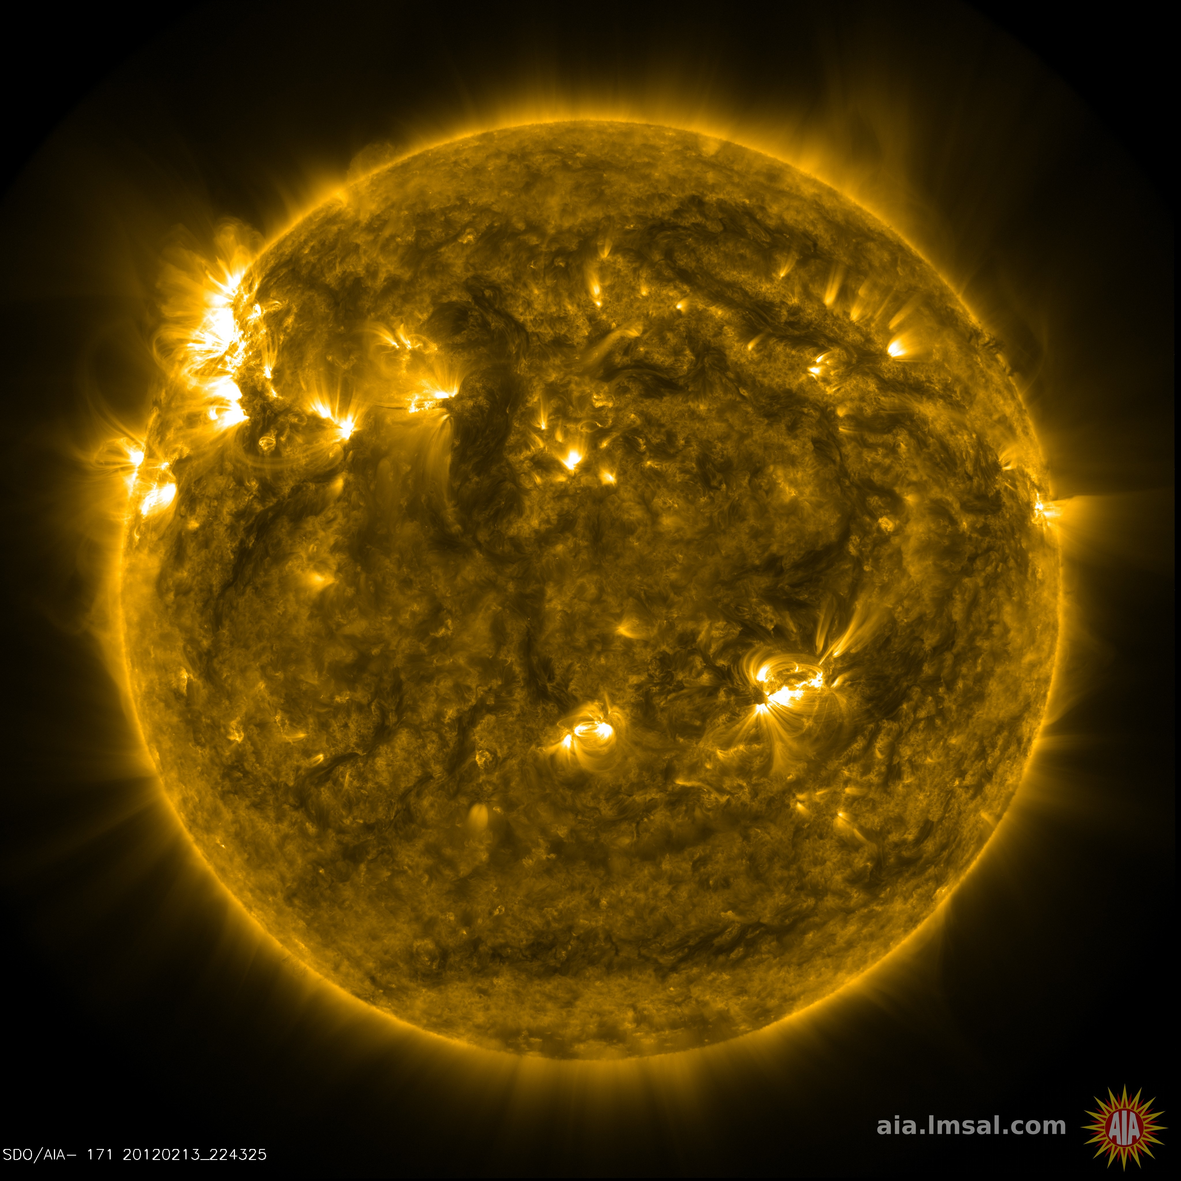

Slide 10
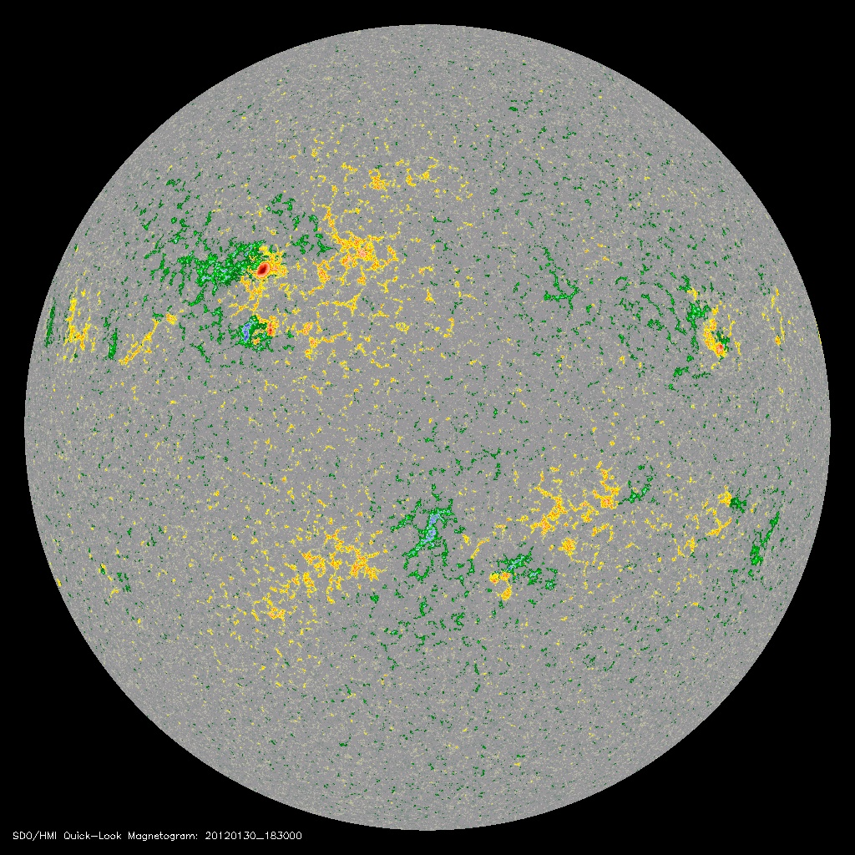
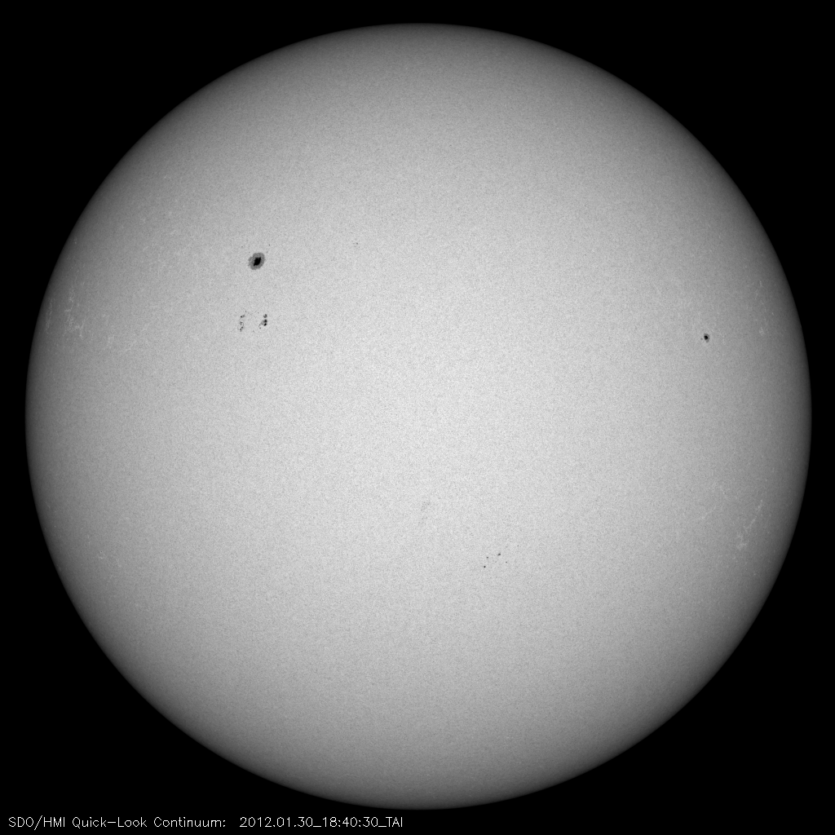
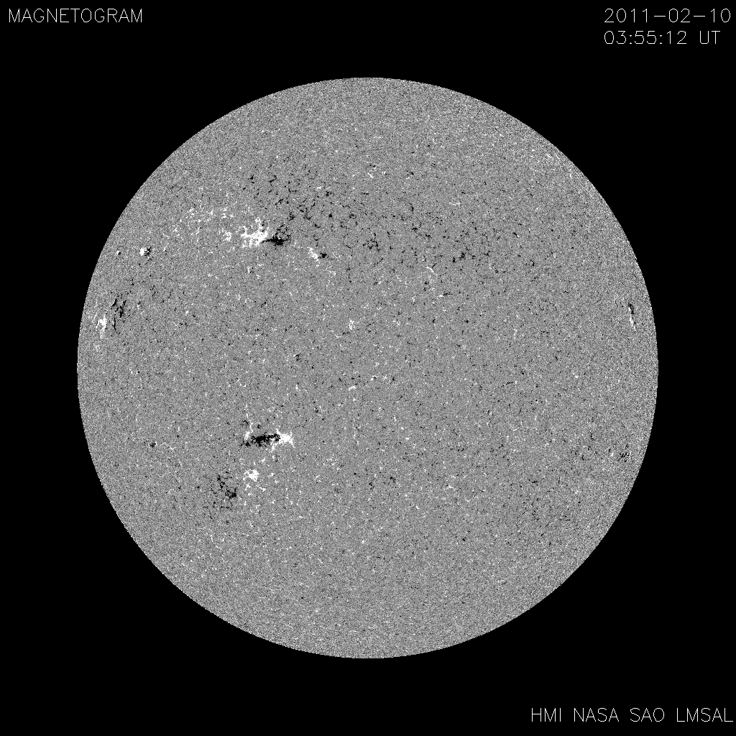
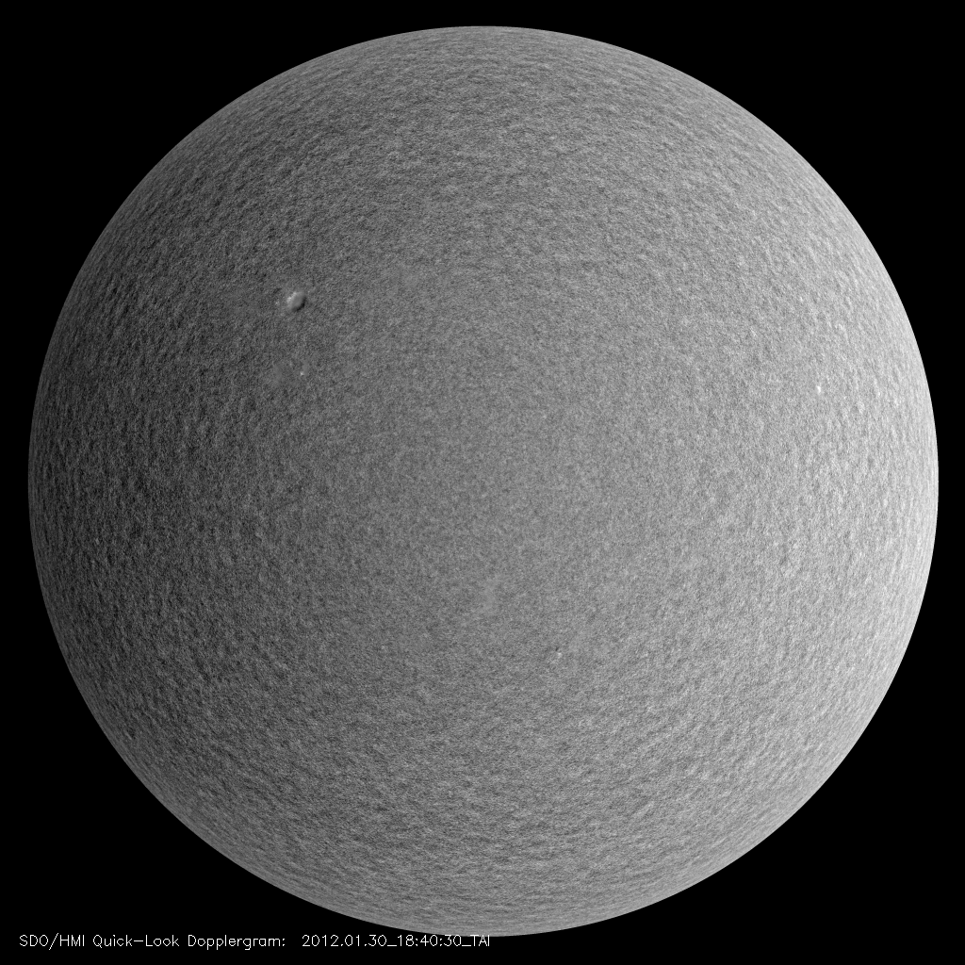
Helioseismic and Magnetic Imager
Aboard SDO, launched 2010
Multiple Filter Imager
Maps of surface LOS velocity & magnetic field
4096px, 0.5’’/px
45 or 90s Cadence

Slide 11
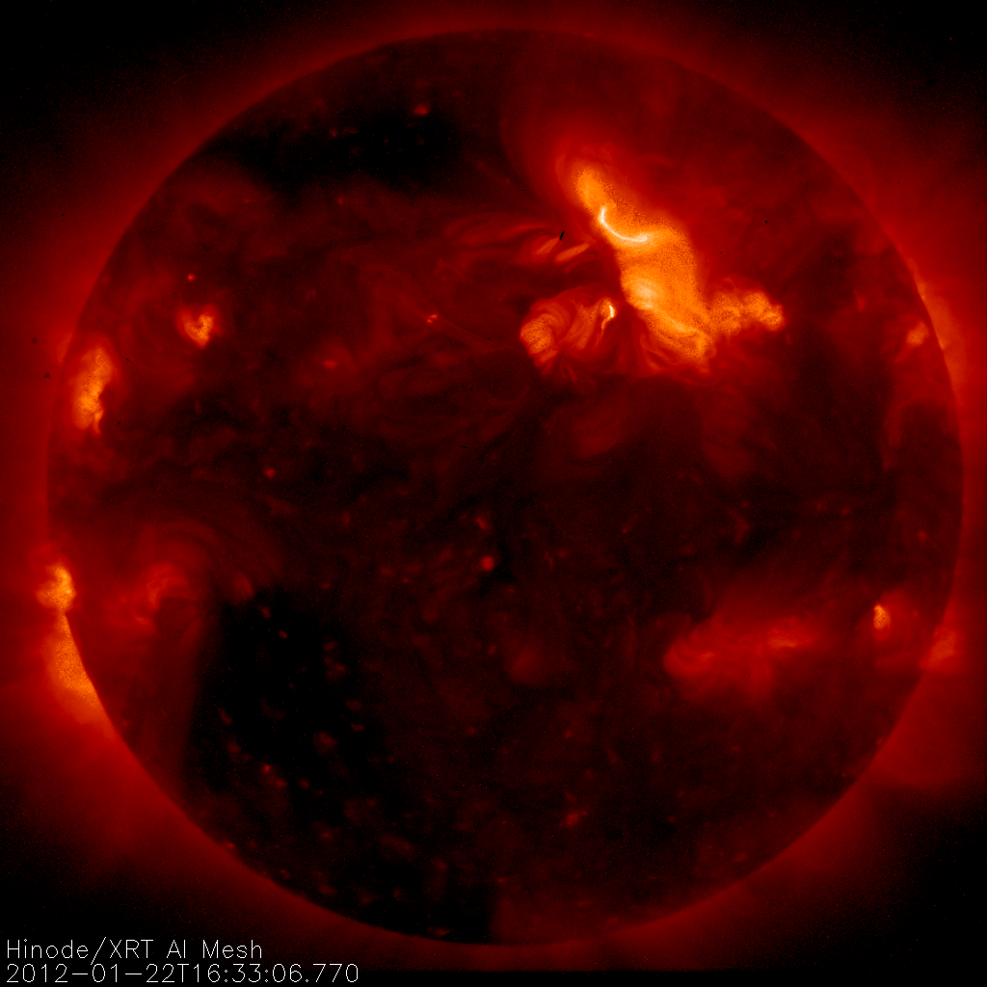
Hinode X-Ray Telescope
Aboard Solar B, launched 2006
X-Ray Imager
9 Filters, log(T)~5.5-9
2048px, 1’’/px
Various cadences, observations
~ 1 GB/day

Slide 12

Interface Region Imaging Spectrograph
Launched June 2013
Imager and Spectrograph
4 Wavelengths in SJI (1330, 1400, 2796, 2832)
NUV and FUV SG
175” slit length
Various cadences, observations

Slide 13
Online Resources Tour

Slide 14
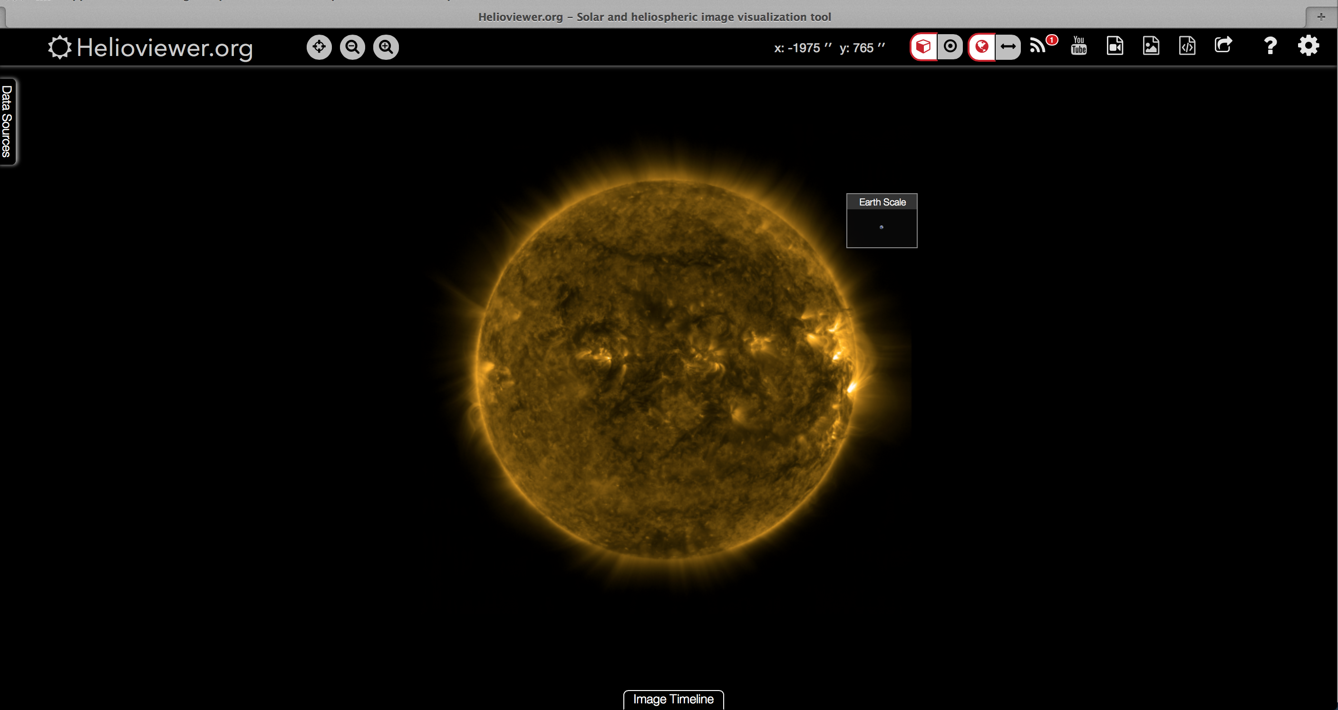
Helioviewer

Slide 15
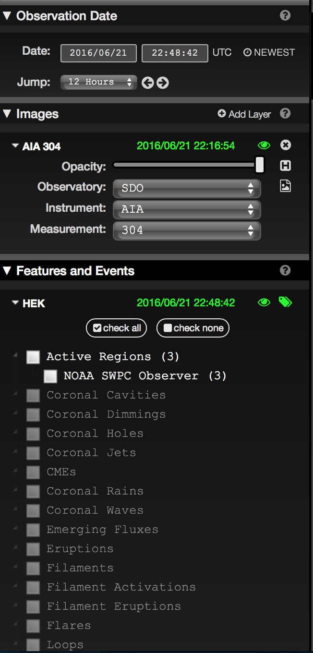
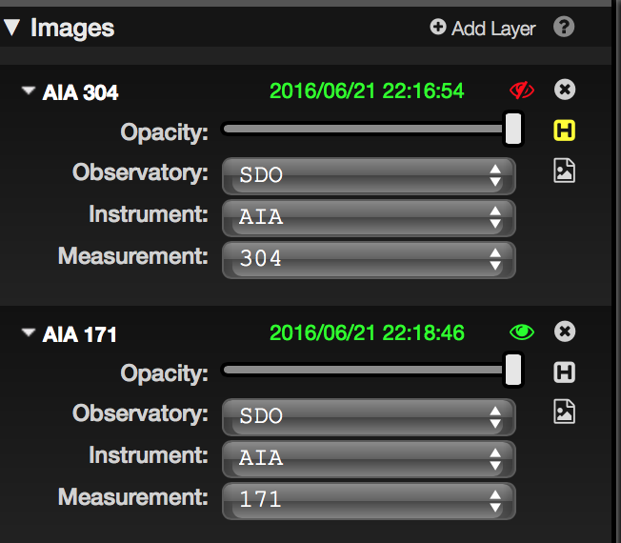
Helioviewer

Slide 16
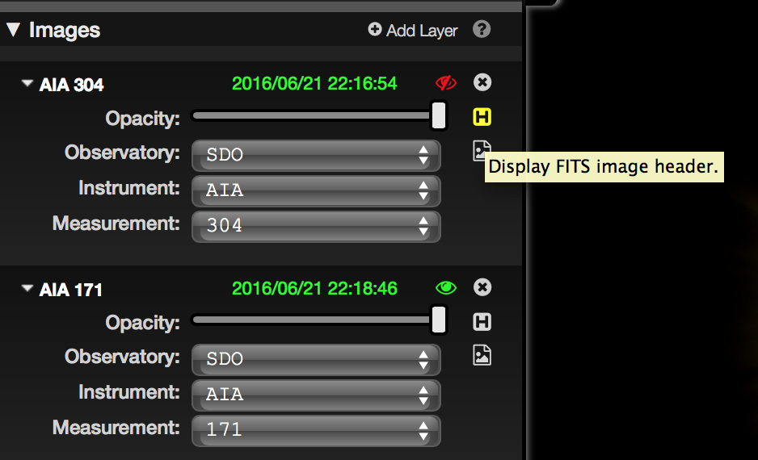
Helioviewer

Slide 17
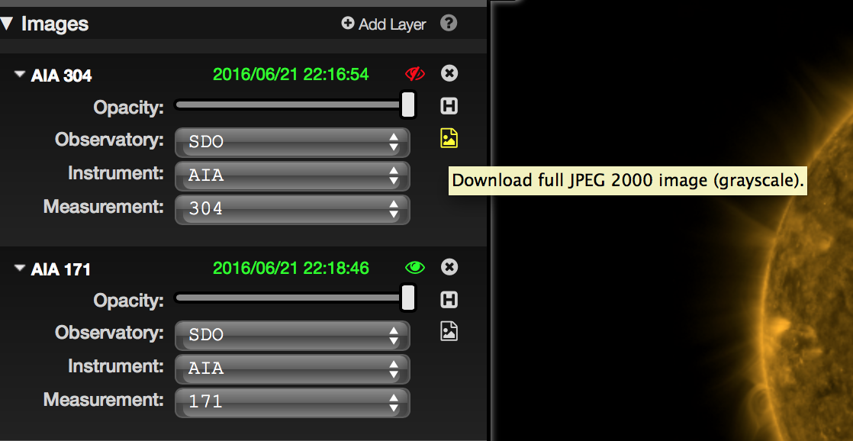
Helioviewer

Slide 18
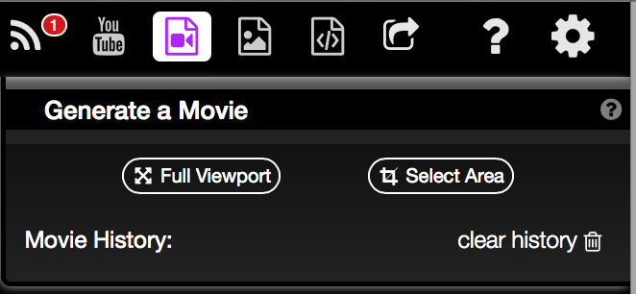
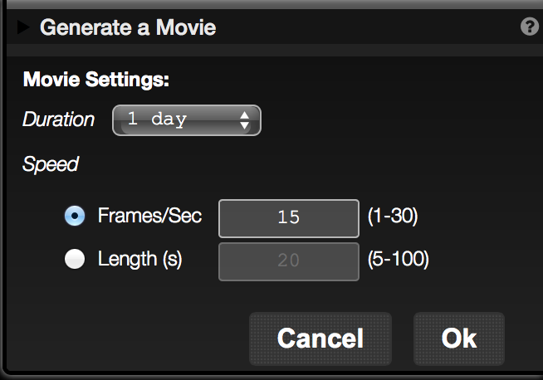
Helioviewer

Slide 19
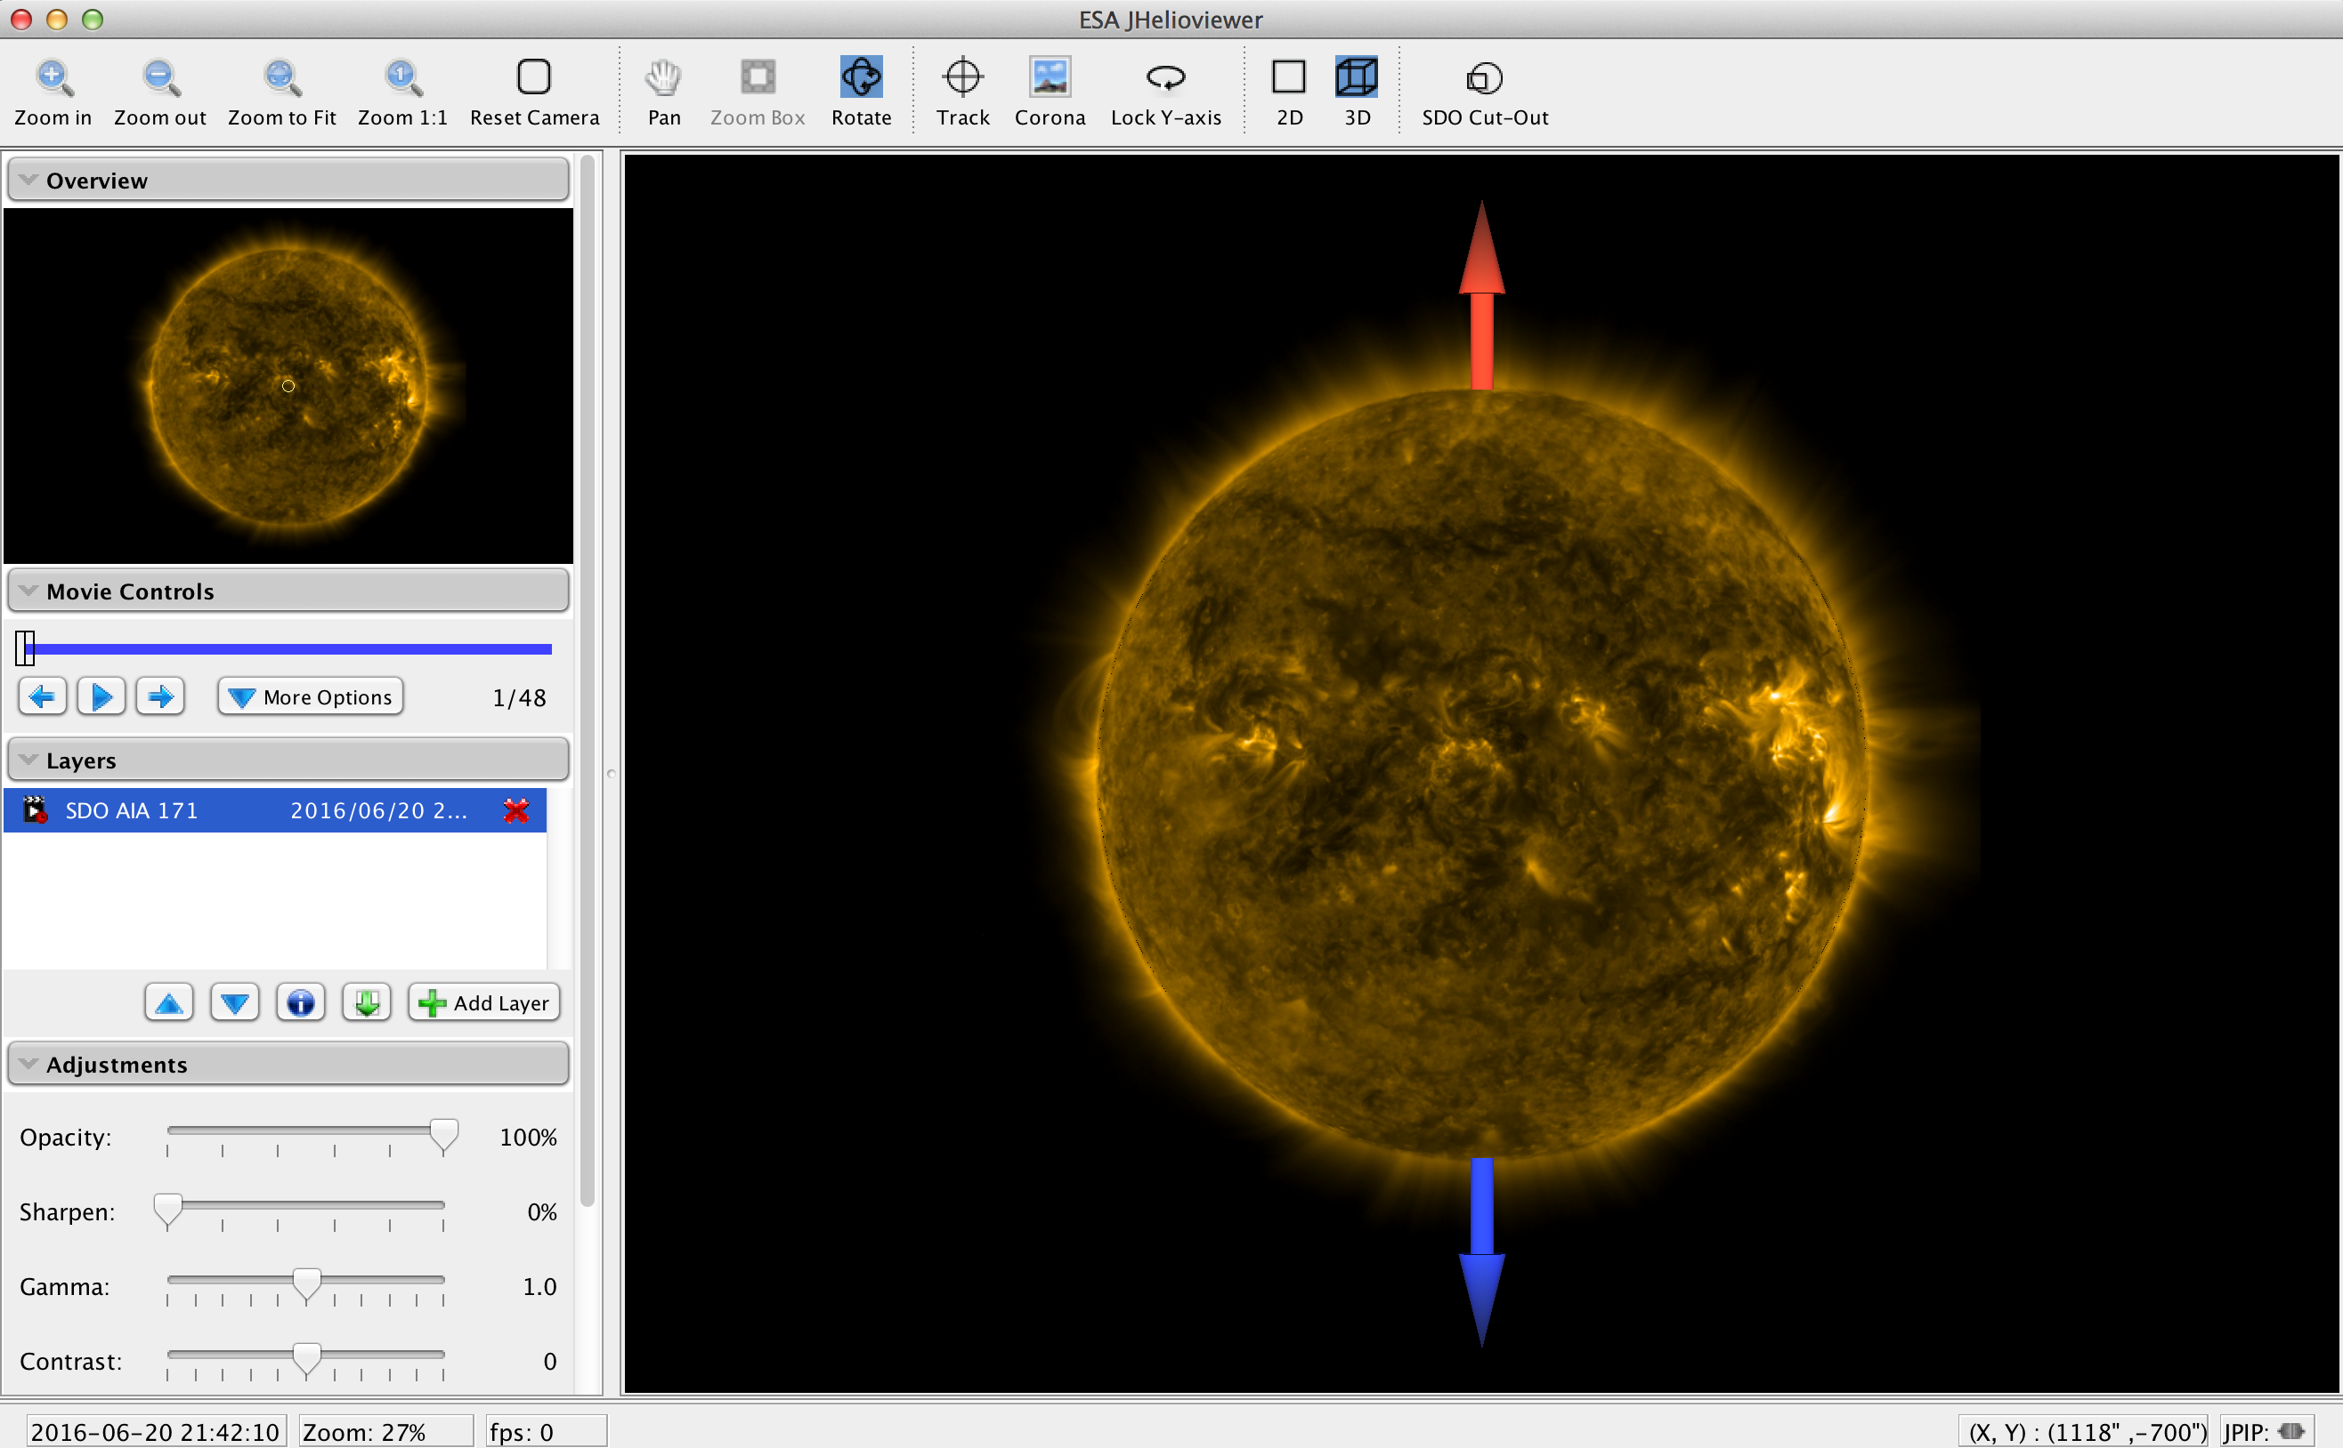
JHelioviewer

Slide 20
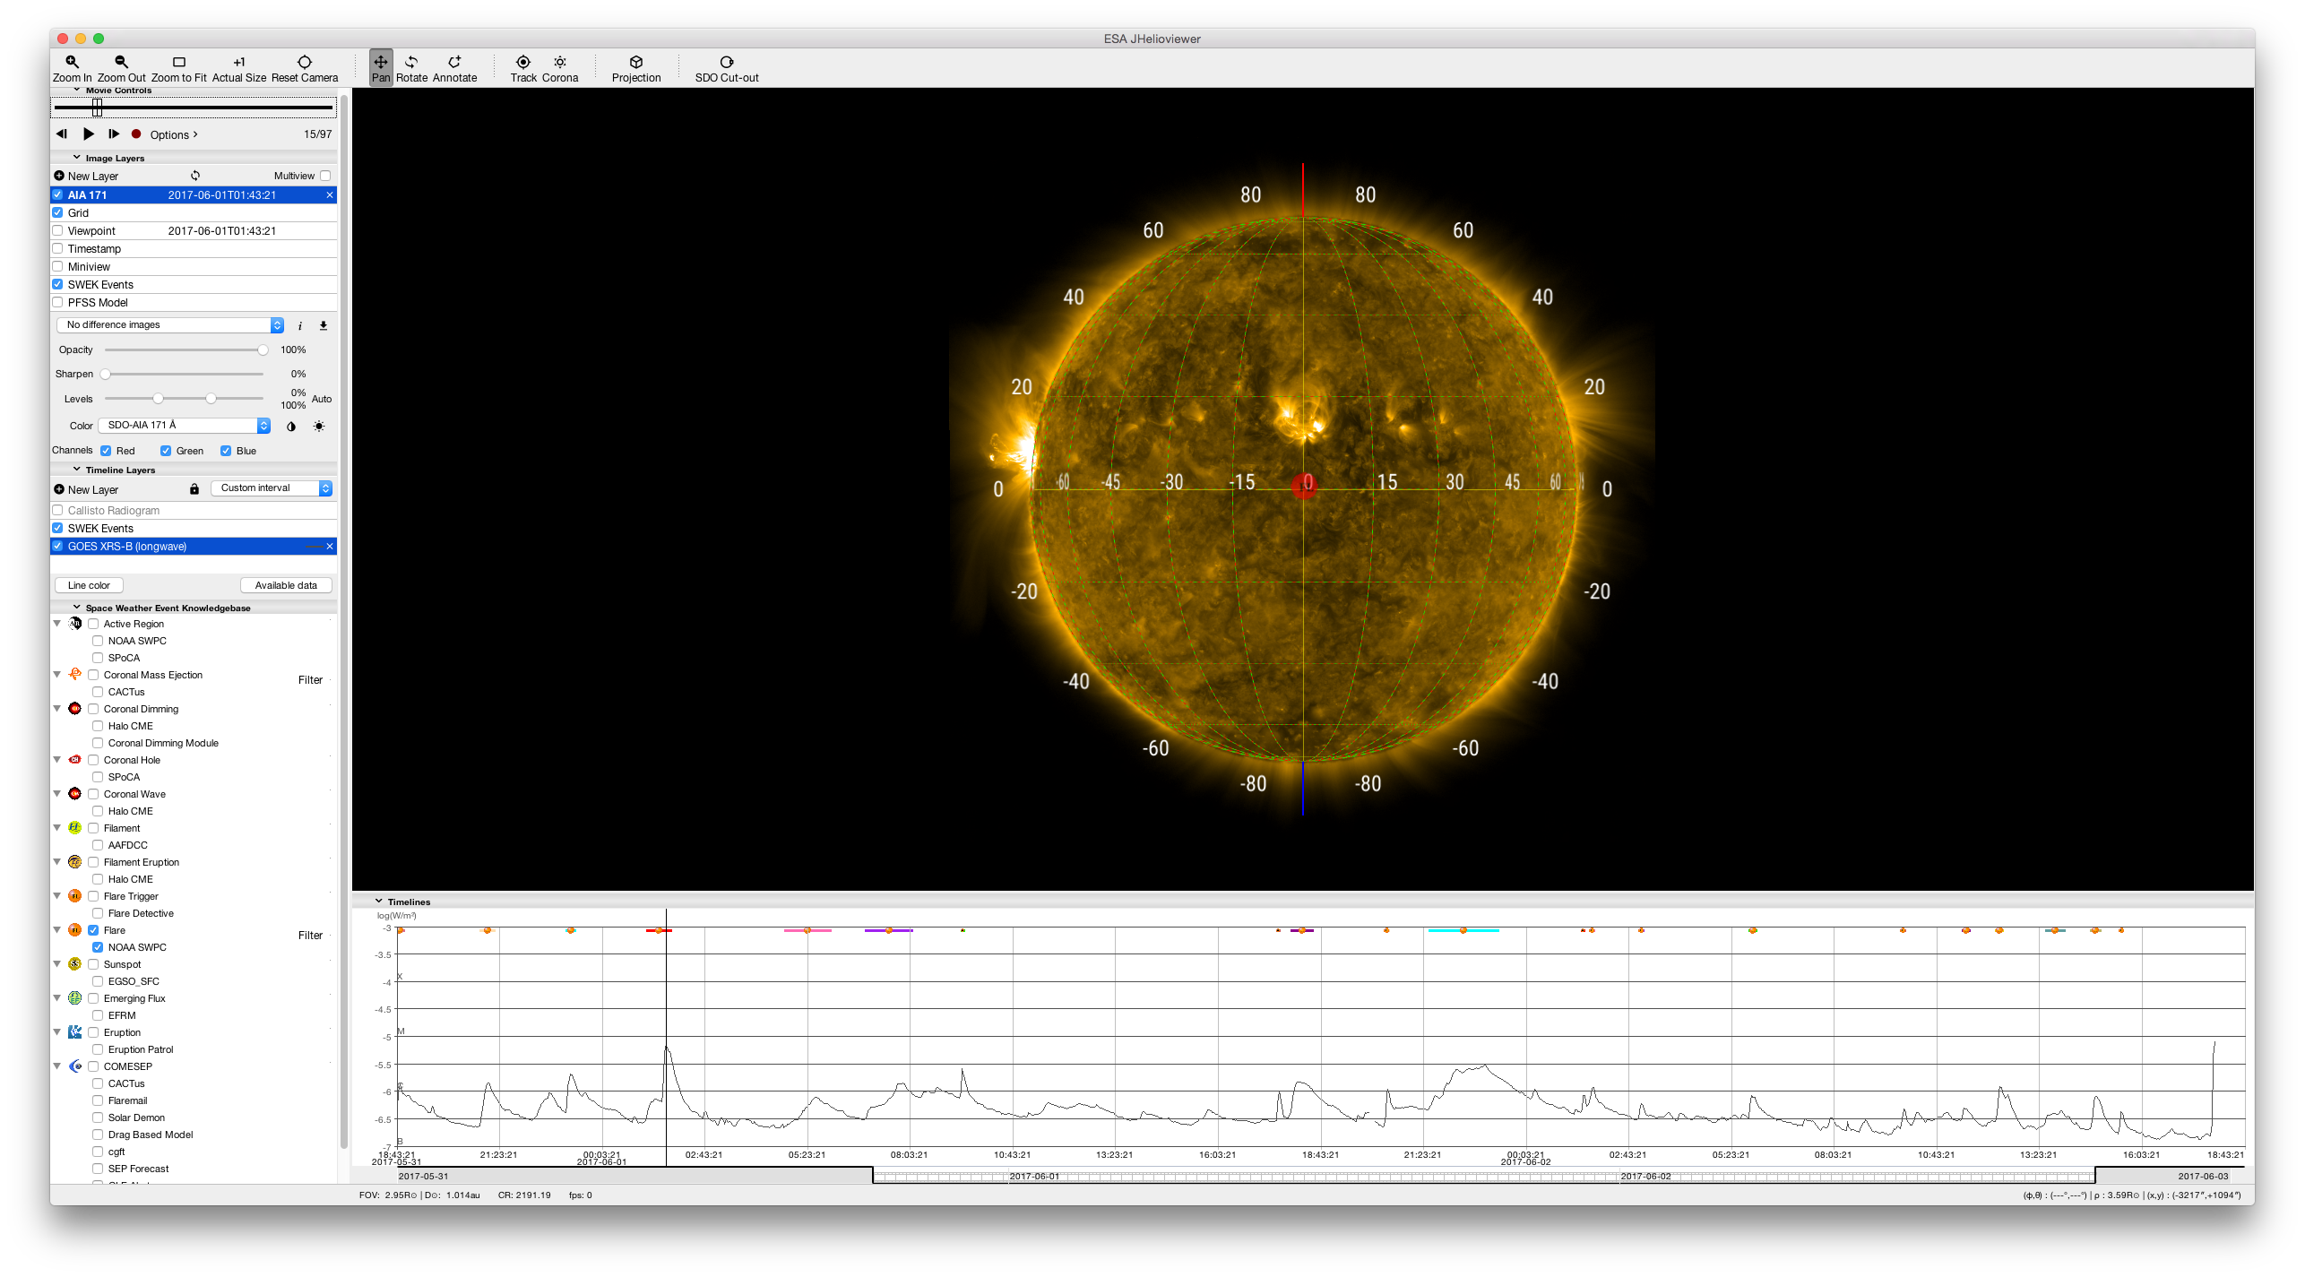
Jhelioviewer (2.11.3)

Slide 21
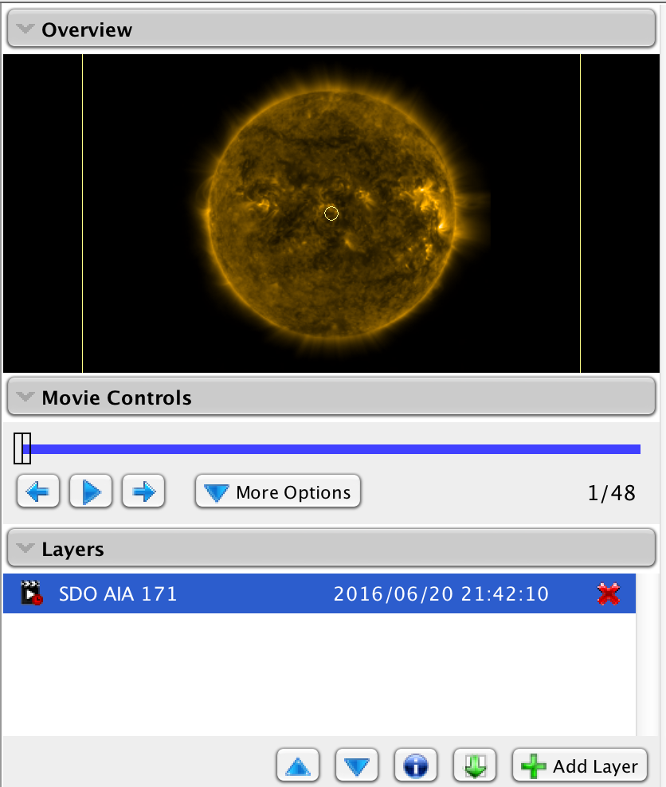
JHelioviewer
Great for viewing movies of data quickly
Many settings to play around with

Slide 22
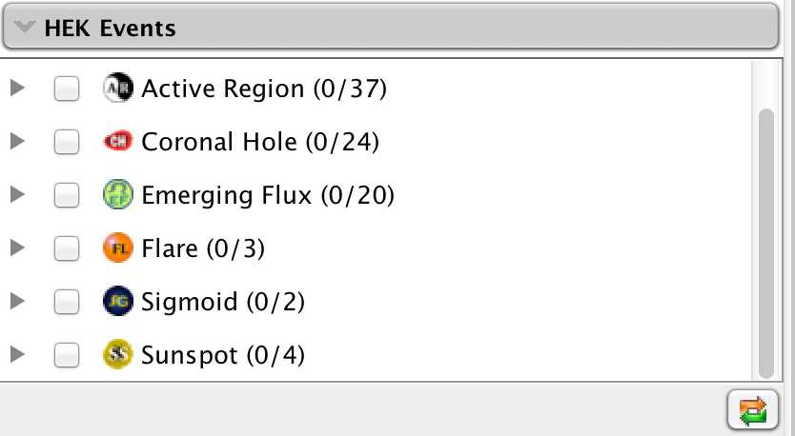
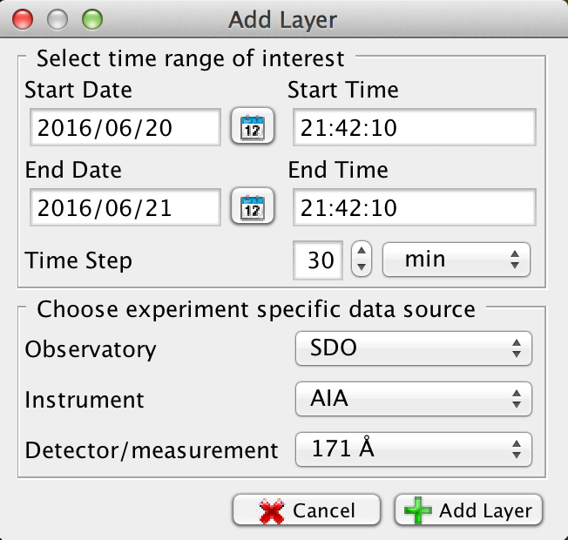

JHelioviewer

Slide 23

JHelioviewer (2.11.3)

Slide 24



JHelioviewer
Old
New

Slide 25

JHelioviewer

Slide 26


Heliophysics Events Knowledgebase (HEK)
http://www.lmsal.com/isolsearch

Slide 27

HEK Summary
Date Range
Sample Image
Symbolic Events
Event Selection
Movie
Get Data
List of Events
Symbol Key

Slide 28

“Get SDO Data” Link From HEK
Notes:
The Rice version is just a compressed file.

Slide 29

Browser for XRT Data
Simply type “browser” (with out the quotes) in terminal window to get this window:

Slide 30


Browser for XRT Data

Slide 31

Browser for XRT Data

Slide 32

Browser for XRT Data

Slide 33

Browser for XRT Data

Slide 34


Browser for XRT Data

Slide 35

Browser for XRT Data

Slide 36

Browser for XRT Data

Slide 37

Browser for XRT Data

Slide 38

Browser for XRT Data

Slide 39
Browser for XRT Data

Slide 40

Browser for XRT Data

Slide 41

Browser for XRT Data

Slide 42

Browser for XRT Data

Slide 43

Browser for XRT Data

Slide 44

Browser for XRT Data

Slide 45

Searching for IRIS Data

Slide 46

Searching for IRIS Data

Slide 47

Searching for IRIS Data
IDL>iris_xfiles

Slide 48



Searching for IRIS Data (Cont.)
SJI
Raster

Slide 49
Local Data
An example path to get AIA data:
/data/SDO/AIA/level1/2012/04/28/H1700
Could also get HMI or EVE data under /data/SDO
An example path to get XRT data:
/archive/hinode/xrt/level0/2010/09/06/H0300
An example path to get IRIS data:
/data/IRIS/level2_nrt/2016/06/14/20160614…

Slide 50

Virtual Solar Observatory (VSO)
Tool to acquire solar data sets
Web or IDL interfaces to search and download data
Many different types of data from many different instruments
http://sdac.virtualsolar.org/cgi/search

Slide 51

VSO Example Search
Search by:
Date/Time and Instrument

Slide 52

VSO Example Search

Slide 53

VSO Example Search
Notes:
The Rice version is just a compressed file.

Slide 54

VSO Example Search

Slide 55
VSO IDL Interface
IDL> search_var = vso_search()
IDL> get_var = vso_get(search_var)
Example:
IDL> aia_data = vso_search(date='2012/1/27T00:00 - 2012/1/27T00:01’, inst='aia', wave='171 Angstrom')
IDL> dl_aia = get_var(aia_data, out_dir=‘/home/jakubprchlik/vso_data/’)
Helpful links for syntax and functionality
Search Data: http://docs.virtualsolar.org/wiki/VsoIDL/VsoSearch
Get Data: http://docs.virtualsolar.org/wiki/VsoIDL/VsoGet

Slide 56
VSO python Interface
Example 1:
python> from sunpy.net import vso
python> import astropy.units as u
python> client = vso.VSOClient()
python> start= “YYYY/MM/DDTHH:MM:SS”
python> end = “YYYY/MM/DDTHH:MM:SS”
python> time= vso.attrs.Time(start,end)
python> ins = vso.attrs.Instrument(‘aia’)
python> wave= vso.attrs.Wave(171*u.AA,171*u.AA)
python> qr1 = client.query(time,ins,wave)
python> res = client.get(qr1,path=‘/download/path/’)
Example 2:
python> import drms
python> client = drms.Client(‘youremail@email.com’)
python> start= “YYYY.MM.DD_HH:MM:SS”
python> end = “YYYY.MM.DD_HH:MM:SS”
python> expt = client.export(‘iris.lev1[{0}_TAI-{1}_TAI][][]’.format(start,end))
python> exp.download(‘/download/path/’,index,fname_from_rec=True)
Documentation for Python Modules
Sunpy (example 1) :
http://docs.sunpy.org/en/stable/guide/acquiring_data/vso.html?highlight=vso
Drms (example 2): http://drms.readthedocs.io/en/stable/
Register Email: http://jsoc.stanford.edu/ajax/register_email.html

Slide 57
Basic Data Prep
AIA Example
Read in the data
IDL> read_sdo, filename, index, data
Example
IDL> read_sdo, ‘AIA20130607_175958_0131.fits’, header, image, /silent, /uncomp_delete
Prep the data
IDL> aia_prep, index_in, data_in, index_out, data_out
Example
IDL> aia_prep, header, image, new_header, new_image
IRIS and XRT Example
IDL>read_iris,'/data/IRIS/level2_nrt/'+year+'/'+month+'/'+day+'/'+obsinfo+'/iris_l2_'+obsinfo+'_SJI_'+wav+'_t000.fits',index,rdata
IDL>iris_prep,index,rdata,oindex,odata
IDL>readcol,filelist,fitsfiles,format='A’
IDL>all = indgen(n_elements(fitsfiles)-1)
IDL>xrt_prep,files,all,index,data,/float,coalign=0,/despike_despot,spotthresh=-1,/quiet
To learn more about these (or other) programs in the SSWIDL library- what they do, keywords, syntax, etc.:
IDL> xdoc, “program name”
…or locate the program file and view.

Slide 58
Thank you!

Slide 59


Sun Today
http://sdowww.lmsal.com/suntoday/

Slide 60

Sun Now
http://sdo.gsfc.nasa.gov/data/

Slide 61

Solar Monitor
http://www.solarmonitor.org
Notes:
Also show Jan 27th and click on the C7.9 flare to show gif animation of a CME from LASCO.

Slide 62

Solar Monitor

